Slide 1
Electric Machine Design Course
Magnetic Materials for Electric Machines
Lecture # 9

Slide 2
Active magnetic materials used in electrical machines
All electric machine types require soft pure iron materials to carry magnetic flux around the circuit.
Impurities like carbon contribute to hysteresis losses
Hi-flux densities & frequencies contribute to eddy current losses
Permanent magnets are considered hard materials
Best grades exhibit high hysteresis residual flux
All electric machines require conductors of electricity
Copper has lowest electrical resistance
Aluminum is a good choice for cast cage rotors

Slide 3
Two magnetic material classes
Soft materials: Small hysteresis
Electrical steels
Pure iron bar stock
Sintered pure iron
Hard materials: Large hysteresis
Permanent Magnets
2.1 Tesla
1.4 Tesla

Slide 4
Electrical steels (soft iron)
Rotor & stator cores from sintered electrical steel grades
Can be used for complicated core shapes
Rotor & stator core laminations punched from electrical steel lamination grades with low cope loss & surface insulation.
Non-Oriented Silicon M-19 grades # 24, # 26 & # 29 gages
Oriented M-3 grades (0.003” thick)
Stator core components from Amorphous materials (MetGlas)
Lowest core losses with fabrication difficulties
Medium to low flux densities (1.56 T max)
Both Fe & Co based alloys available

Slide 5
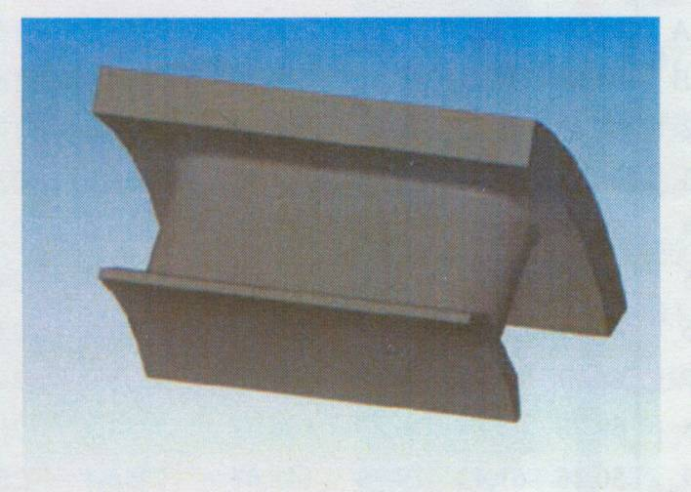
TITLE
Soft Sintered Magnetic Materials

Slide 6
Powdered soft iron magnetic components
SOLALOY iron coated magnetic powders with
an insulating layer and compacted into complex shapes used for electric motor stator & rotor
components .

Slide 7
ASTM vs. EN/IEC gages & core losses

Slide 8
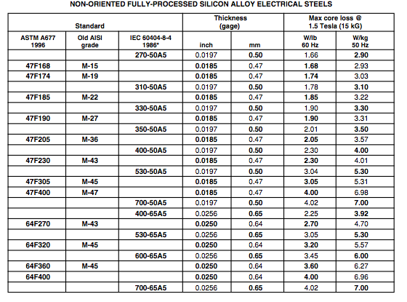
Electrical steel grades for laminated cores

Slide 9
Misleading B-H plots for electrical steels

Slide 10
Low loss electric steels for medium to high frequency machines
Frequency = rpm x 2p / 60

Slide 11
Lamination coatings to insulate against eddy current losses

Slide 12
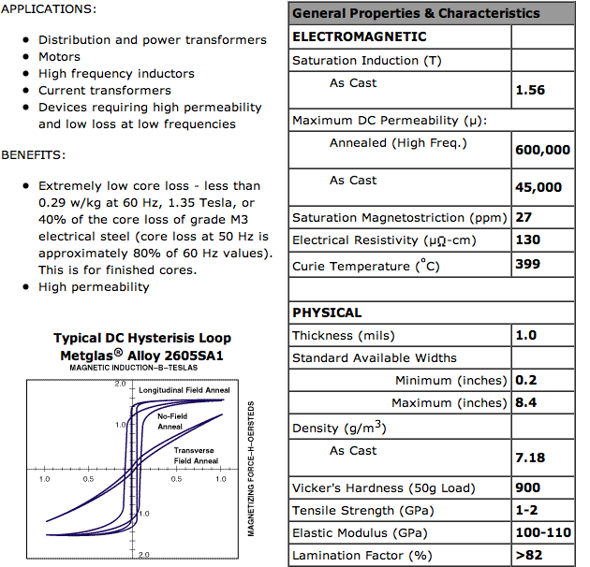
TITLE
METGLAS
Soft Iron
lowest core loss materials
Very thin & difficult to punch for
motor cores

Slide 13
Losses in electrical steels
Iron loss: losses generated in the iron core parts
such as stator yoke and stator teeth are caused by changing magnetic fields.
Total iron losses are composed of two loss components:
Hysteresis losses
Eddy current losses

Slide 14
Calculation of Hysteresis Loss (Watts)
by analytical means or FEA
Modeling methods such from Preisach, Hysteron & Curling are used for hysteresis loss calculations or predictions
Hysteresis losses are equal to area inside
of the B-H loop charted when material is
subjected to magnetization to saturation
and complete de-magnetization
Hysteresis Losses::
f = frequency
t = lam thickness
σ = lam conductivity
ρ = density
M= Mass of core
C = Steinmetz
hysteresis
coefficient

Slide 15
Calculation of Eddy Current Loss (Watts) by analytical means or FEA
f = frequency
t = lam thickness
σ = lam conductivity
ρ = density
M= Mass of core
C = Steinmetz
hysteresis
coefficient
Eddy Current Losses:
Calculate sum of each part of the stator lamination
Multiply by watts/Kg and sum losses.
Note: might be different in lamination sections
such as stator vs rotor or yoke & teeth

Slide 16
Separation of Hysteresis & Eddy Current Losses

Slide 17
Radial or parallel orientation & magnetization
Approximate same flux from both magnets !

Slide 18
Permanent Magnetic Comparisons
All current magnet
grade categories
/4800
/4460
/550
/5.5
NdFeB Grades

Slide 19
Permanent magnet grades
Magnequench

Slide 20
High flux ceramic magnet (TDK FB12B)

Slide 21
Permanent Magnet Summary

Slide 22
Low cost magnet material comparison

Slide 23
Neodymium Boron Iron magnet grades

Slide 24
Samarium Cobalt grades

Slide 25
Samarium Cobalt, B-H data vs. temperature

Slide 26
Samarium Cobalt B-H data (550 deg C)

Slide 27
Load line of magnet with air-gap & de-mag plot
NdFeB magnet data
Load line
Plot load line & project to B_{m} and read B_{g}
Move load line to intrinsic curve knee, Read (– H) value @ *
and convert to peak de-mag phase amps.
Read 7 kO_{e} converts
to 557,042 NI/M
Divide by the magnet path length and the number of turns and the result is the min de-mag current
1.1 T = B_{g}
@
*

Slide 28
Normal & Intrinsic B-H curves
Second quadrant is the de-magnetization curve
The normal curve plot frequently does not show the “knee” of the curve as it appears in the third quadrant
The Intrinsic plot of the same data moves the knee into the second quadrant where the load line can be placed right before the slop of the curve begins to change.
For each –H value, positive value of –H is added to the corresponding B value for the intrinsic plot.
MMPA

Slide 29
De-magnetization study
Pc = L_{m}/L_{g}
= (Load line)
-H max for zero
de-magnetization
-H max

Slide 30
TITLE

Slide 31
TITLE

