Slide 1
Electric Machine Design Course
Losses in Electrical Machines
Lecture # 6

Slide 2
Induction motor loss distribution

Slide 3
Definitions of losses in electric machines
Stator Ohmic losses result of current flowing against phase resistance
Rotor Ohmic losses result of current flowing against rotor bar resistance
Stator core losses with two components: Hysteresis & Eddy Current
Rotor losses from eddy currents in magnets, cores, retention sleeves
Mechanical losses from air-gap windage & bearing friction
Stray load losses are principally from load current reactance fluxes

Slide 4
Losses in other machine types
Stator loss sources are identical to AC induction for many electric machine types
PM-AC Synchronous & PM Brushless
Wound field Synchronous
Reluctance Synchronous
Synchronous machine rotor losses are generally lower than AC Induction rotors
Very low for wound synchronous & RSM types
PM rotor machines can produce eddy current losses in rotor yoke, rotor core 8 retention sleeve

Slide 5
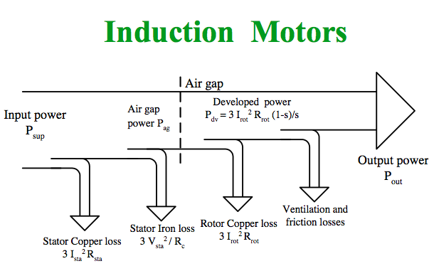
Induction machine losses vs power flow
=15%
= 25%
= 25%
= 35%

Slide 6
Stator core losses

Slide 7
Electric machine loss reduction - a
All losses cause machine heating & effect efficiency
Heat reduction strategies for increasing torque density
Forced air cooling (internal or external)
Liquid cooling of frame and core
Direct liquid cooling of phase conductors
Oil splash or nozzle spray cooling of rotors
Thermal conductive encapsulation of stator
Improving torque and power densities in existing machines is often a very useful activity but improving efficiency in new or redesigned machines is a typically
a more desirable activity

Slide 8
Electric machine loss reduction - b
How to minimize electric machine losses
Since torque/amp = flux times stator conductors use strong magnets to minimize number of turns
Use copper rotor bars rather than aluminum
Use more copper in phase coils for higher slot fills
Wind phase coils with shorter end turns
Stamp stator cores from lower core loss steels
Use insulating core plating on laminations
Minimizing core fabrication losses
Design for smaller magnetic air gaps
Design for reduced flux and current densities

Slide 9
SPM & IPM brushless machine rotor losses
Eddy currents in core or back iron (laminated or solid).
Eddy currents in permanent magnets (solid or segmented).
Eddy currents in magnet retention sleeve or wrappings.
Laminated or solid rotor core losses.
Air gap windage friction (air or fluid).
Bearing friction losses (sleeve, ball or roller).

Slide 10
Eddy currents in magnets & soft magnet steels
Eddy current magnitudes in magnets reduced by segmenting the magnets into bonded slices for each pole
Eddy current magnitudes in motor yokes and teeth are reduced by laminating with thin sheets or using sintered materials

Slide 12
Hysteresis in magnetic materials
Soft magnetic materials Hard magnetic materials
(Electrical laminated steels) (Permanent magnets)

Slide 13
Core loss calculation models
Overview & Comparison of Iron Loss Models for Electric Machines
EVRE, Monaco, 2012 by A. Krings & J. Soula

Slide 14
Factors effecting core losses
Electrical steel grade & thickness, 0.35, 0.50, 0.65 (mm)
Pre or post punching wet forming gas anneal
Work hardening of sheared edges stamping process
Surface coating, iron-oxide or core plate
Welding process to fabricate cores
Lamination interlocking process to fabricate cores
Grinding or machining core OD or ID
Radial stresses from housing shrink fits

Slide 15
Core loss calculations W/Kg

Slide 16
Core loss comparison two common steel gages

Slide 17
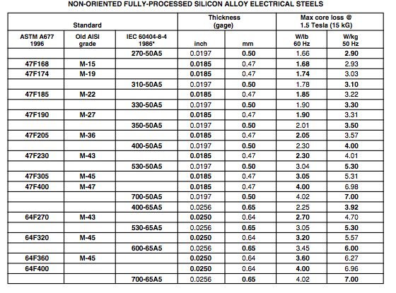
Fully processed silicon steel grade losses vs. gages

Slide 18
Assembled core losses vs. lamination losses
Standard core loss data taken under ideal conditions
Standard Epstein frame data old method
Motor magnetic circuits are round not rectangular
Core manufacturing processes adds additional losses
Welded cores allow additional eddy currents
OD & ID grinding provides eddy current paths
Die cleated cores allow eddy current paths
All strapped or riveted cores yield eddy currents
No core plate* yields higher eddy currents
* Core plate is an insulation coating one laminated steel stock

Slide 19
Guidelines for open circuit flux density

Slide 20
Standard Epstein frame for core loss testing

Slide 21
TITLE

Slide 22
TITLE

Slide 23
TITLE

Slide 24
TITLE

