Slide 1
Electric Machine Design Course
Practical Design Process for Electrical Machines
Lecture # 4

Slide 2
Suggested electric machine design steps
Review specs
Power
Voltage/current
Efficiency
Cooling method
Envelope
Sizing
Machine configuration
TRV and air gap
shear stress
Electric loading
Magnetic loading
Materials
Lamination steel
Conductors
Magnet material
Rotor retention
Sintered cores
Adhesives
Potting Compounds
Predict Results
Shaft torque/Power
Phase current/voltage
Efficiency
PSI in air gap
Torque vs. Speed
Peak Torque/Power
Back EMF (PM Types)
Losses
Compare Motors
PMAC SPM
PMAC IPM
RSM
AC Induction
SR ?
Initial Design Tasks
Poles/slot selection
Rotor/stator dimensions
Back EMF (PM types)
Winding design
Flux distribution
Turns per coil

Slide 3
More details of machine design process for this course
Review Specs
& SIZE
Select machine type
Select pole number
Design stator
Select active materials
Design
Rotor
AC Induction
Results might require design modifications
BLDC
PMAC
RSM
Complete magnetic circuit cross sections
Design
Report
Thermal analysis
Solve machine results from either analytical equations or FEA
Calculate magnetizing flux & phase windings

Slide 4
Design process for electric machine design
1- Start with a specification including performance requirements & SIZE
2- Select machine type, AC Induction, BLDC, PMAC or RSM
3- Establish number of poles (Choose if not in spec)
4- Based upon cooling size rotor (assuming max .stator OD)
5- Estimate rotor design (separate process for each motor type)
6- Select stator slots and phase windings
7- Select magnetic materials, (electrical steels, magnets, Cu vs. Al)
8- Estimate magnetizing flux and select turns per coil & wire gage
9- Finalize circuit cross sections, (yokes and teeth dimensions)
10- Solve for performance results (using analytical equations or FEA)
Design step details vary with machine
types and specification requirements

Slide 5
Most any electrical machine can be used for motoring or generating or both
For motoring, the efficient production of shaft torque at desired speeds is the most important parameter to understand, design, predict & validate.
For generating, the efficient production of electrical power at certain speeds and voltages is the most important parameter to understand, design predict & validate.
Some IM & BLDC machines must be designed to be both generators and motors such a starter/generator for a gas turbines or IC engines.
(See four quadrant operation in Lecture # 2)

Slide 6
Classical design vs. practical design
Historical electric machine design courses and workshops
- Provide in depth analysis of classical concepts
Maxwell equations
Biot-Savart’s Law
Lorentz forces
Ampere’s Law
Faraday’s Law
- Frequently there is insufficient time for teaching actual machine design steps that must be left up to the students
to learn on the job depending upon their interest
The purpose of these lectures is too fill in that gap, to provide a process for the design process along with practical guidelines based upon a century of experience from the countless number of electric machine designers and engineers around the world.

Slide 7
Analytical motor design calculations vs. FEA method
Prius IPM
Analytical methods assume uniform flux densities in cross sections
Flux leakage predictions are difficult with analytical methods
Magnetic saturation is difficult to account for without FEA analysis
Some analytical calculations require calibration factors from actual measurements takes from similar tested machines

Slide 8
Important machine design considerations
Machines design for low cost mfg. to compete sometimes dictate designs
Existing infrastructure for manufacturing, winding & assembly tooling
Existing tooled components such as stator/rotor laminations
High volume potential in new market allows new tooling and infrastructure
Design can be optimized without manufacturing restraints
Allows “clean sheet of paper design”
Allows unusual configurations and magnetic material choices
(Such axial flux and transverse flux or hybrid PM/SR configurations)
Compact high torque/power density requirements (extreme cooling required)
Short end turn phase coils
High copper slot fill percentages
Hollow round or rectangular conductors (can be internally cooled)
Difficult operating environments, vacuum, hermetic, nuclear, cryogenic or hot.
Special materials and manufacturing processes

Slide 9
Comparison of machine types
AC Induction, SPM-AC brushless & IPM-AC brushless machine comparisons, 75 HP, 1800 rpm, voltage range 400 to 460, common stator core with different windings,
A comparison study of IM and PM machine (M. J. Melfi, S. Evon and R.Mcelveen, “Induction vs Permanent Magnet Motors”, IEEE Industry Applications Magnazine, pp. 28-35, Nov-Dec 2009)

Slide 10
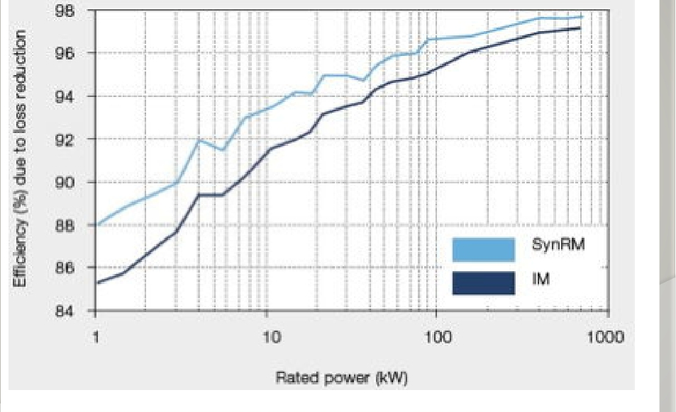
RSM machine comparison to IM
Data from ABB

Slide 11
Machines with non-salient pole rotors
AC Induction (IM) PM Synchronous, Wound Field Synchronous & RSM
Phase most common for all non-salient pole machines: (3, 6, or 9)
Same stator punching can be used for all
New rotor design for each one
Lamination materials are the same
Phase windings can be the same
PM synchronous need not have same pole number if both rotor & stator
Begin with scaled motor cross section to use working the final design

Slide 12
Design of common components
Initial SIZING based upon cooling, duty cycle and specifications
Selection of slots, poles and phases (rotor bars for AC induction)
Certain SPM machines might use single tooth windings
Stator lamination design, electrical steel choices
Iron loss considerations
Select necessary insulation class to meet specification
Stator phase windings and coil placements (turns/coil later)
Plan for potential cooling using air or liquid

Slide 13
Switched Reluctance Double salient pole machines
SR machines require unique active magnetic components
Rotor, Stator punchings and cores as well as phase coils
SR drives and controls are unique, each phase is controlled separately.
Higher grade electric steels must be used due to higher frequencies
Audible noise issues mitigated by thicker yokes and higher pole numbers.
Therefore no SR design lectures are included in this series

Slide 14
Principles of electric machine design
Focus on designing electrical machines to produce torque efficiently rather than focusing on producing power.
Torque is produced within air-gap between rotor & stator two different ways
Non-salient pole machines, Lorentz forces (F =B l I ) times radius
Salient pole machines, reluctance force time radius
Both cases magnetic forces are used to produce torque because the minimization of magnetic field energy as the air gap is reduced between the rotor poles and the stator.

Slide 15
Flux linkage considerations for basic design
Torque/A is produced in the air gap between rotor & stator
by flux linkage of rotor and stator
After basic SIZING the flux is first determined or estimated
For PM machines magnets provide the circuit flux.
For RSM & IM part of the stator NI (amp-turns) is responsible for creating the circuit flux so one starts by an estimation of 0.65 to 0.85 Tesla in the air-gap
After the circuit is adjusted for those flux levels the turns per coil are calculated (or total conductors in the stator)
Performance is next studied with re-iterations if required
Finally thermal calculations to predict temperature rise

Slide 16
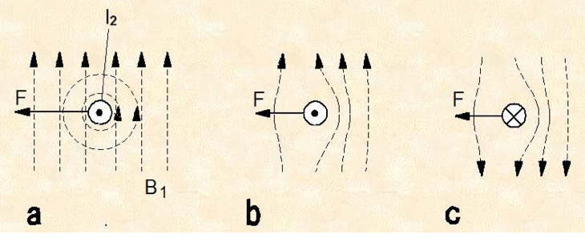
(F) Force on phase conductors – Lorentz force
Note: Magnetic field is being pushed or minimized

Slide 17
Title

