Slide 1
Electric Machine Design Course
Three Phase Power Converter
Control Strategies for Three Machine Types
Lecture # 3

Slide 2
Universal inverter L1000A

Slide 3
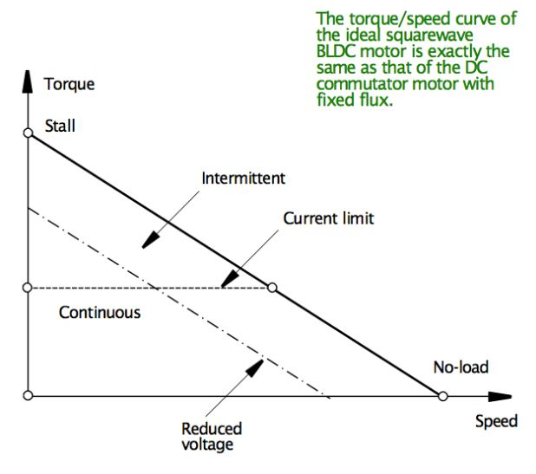
BLDC Torque vs. Speed plot

Slide 4
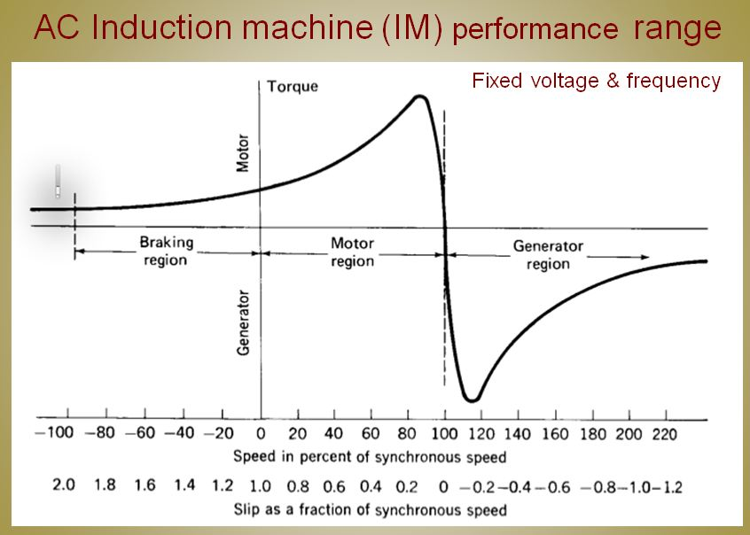

Slide 6
Introduction to the control of motors with PM rotors
First brushless motor used about (40) or so years ago were trapezoidal driven for simplicity and low cost. This close represented a PMDC motor.
This (6) step or “trap” drive method is by far the most widely used with multiple billions shipped around the world during the past 40 years.
(Hard disc drives alone use 0.6 billion trap driven brushless motors each year! In addition each drive uses at least one DC brushless cooling fan)
It is reasonable to suggest that the total world production of trap driven PM brushless motors exceeds all other motors combined each year for all of the last 15 or more years. (Probable nearly two to three times as many)
Historically, the second most popular brushless drive has been the current hysteresis sine drive with 180 degree phase commutation all three phases producing simultaneous torque.
For high performance machine applications (name changed to PMSM)
the d & q current flux vector sine drives have replaced the hysteresis sine drives. (Perhaps a few single digit millions sold last year at most, as of 2012)

Slide 7
Introduction to brushless DC control & PMAC Synchronous machine control
Some early PM brushless machines were driven two phase
(Hall sensors or opto’s used for shaft feed back commutation)
Three phase machines have become the most popular
(Six or even nine phases are sometimes used)
Three principle power converter topologies for power & control
1- (6) step control, 120 deg E commutation, only (2) phases on
2- Hysteresis current phase current, 180 deg E commutation
3- I_{d} & I_{q} sine current control,180 deg E commutation
In all cases the currents are limited by voltage PWM chopping
Low pwm f results in poor current shapes & motor harmonics
High pwm f increases transistor switching losses
(Motors likes perfect sine wave current - so compromise?)

Slide 8
PM back EMF wave form comparison
Most PM machines produce back EMF voltage shapes somewhere in between
Red EMF ideal for 6-step drives
Blue EMF ideal for sine drives

Slide 9
Six-step drive for PM brushless motors
Also known as trapezoid drive
freescale

Slide 10
Six step control, 120 deg E commutation
Same sequence for Wye or
Delta phase connections
Six step or square wave motor control configurations are typical for brushless DC motors used for fans, disc drives and other constant or simple variable speed applications.
Two phases are producing torque at all times during operation
Shaft angle feedback sensing is required (Halls or sensorless)for commutation

Slide 11
Trapezoid 120 deg. E commutation
Back EMF of each phase
(shape not important)
Sensor angular locations
relative to stator phases
so aligned to back EMFs
(3) shaft position sensor outputs
(usually TTL hall signals)

Slide 12
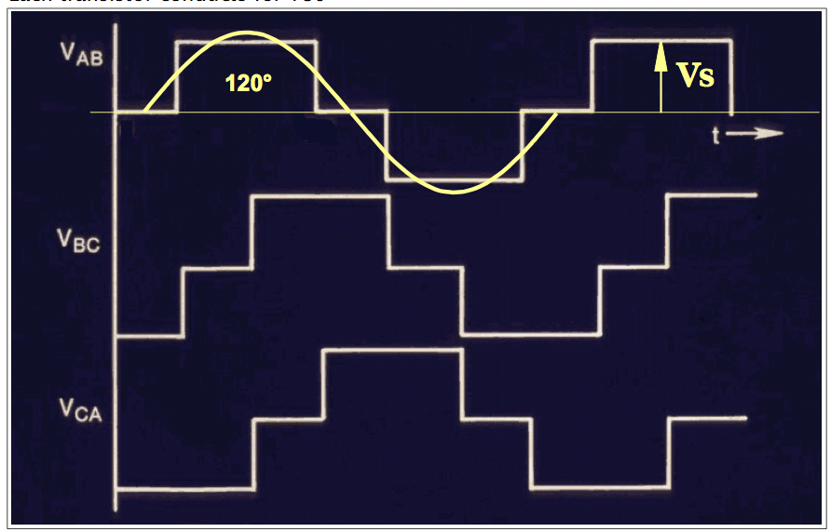
(6) Step 120 degree commutation
Back EMF
Current
Prof. TJE Miller

Slide 13
Phase current plots at (2) speeds & (2) drives
6-Step,120 deg. commutation with (2) phases producing during operation
6-step, 1 krpm 6-step, 2 krpm 6-step, 2 krpm,
(25 deg. advance)
SAME (8) POLE MOTOR
Sine driven
(3) Phase
360 deg.
commutation
Sine current, 1 krpm Sine current, 2 krpm
(0 deg. advance)

Slide 14
Sine 180 deg. E vs. (6) step 120 deg. E
Torque output comparison with vs. 6-step currents for Sine back EMF machines
Sine Torque
(6) Step Torque
Metin Aydin, Turkey

Slide 15
TITLE

Slide 16
Hysteresis current control
Prof. TJE Miller

Slide 17
Vector Control (FOC) for PM machines
FOC (field oriented control) overcomes limitations of other drives
Trapezoid controllers limit the motor low speed accuracy
Hysteresis current control at high speeds yields reduced efficiencies
FOC controls the current vectors and voltages at the D & Q axes and maintains a constant quadrature field independent of the PI controller bandwidth.
The stator phase currents are transformed into D & Q current vectors & compared with zero & the torque reference. Any errors are inputs to two PI blocks. They generate signals to the D-Q reference plane and then are transformed to the stator domain. Then the stator phase currents are generated from the PWM signals to control torque.

Slide 18
Clark & Park transformations used for vector control and space vector modulation (Used for IM, RSM & PMSM machines)
Vector math manipulation to transform (3) phase - current vectors into two control current vectors I_{d} & I_{q} using the voltage equations and d & q axis phase inductances for the control of shaft output torque (+ & - torques).

Slide 19
FOC (Field Oriented Control) for IMs

Slide 20
Advantages of Multilevel converters for motor control
1. They are suitable for medium to high power ^{applications.}
^{2.} They are an ideal interface between a utility & ^{renewable energy sources}
3. Their efficiency is very high (>98%) because of the ^{minimum switching (f)}
4. They can improve the power quality and dynamic stability for utility systems.
5. Switching stress and EMI are low.
6. Because of their modular and simple structure, they can ^{be stacked up to an}
almost unlimited number of levels.

Slide 21
(3) Level Inverter schematic using IGBT Modules

Slide 22
How useful is this to the electric machine designer?
The engineering team assigned to develop the electronic power converter:
Details are most important for choosing the lowest cost and most functional drive topology to meet the specification.
Assuming this team must perform initial motor-drive commissioning, this topic is most important for using Simulink and perhaps Opal-RT plus other tools to get everything running up to spec smoothly.
The engineers who actually design the motor or generator:
Interesting technical stuff but detailed knowledge of inverter topologies does little of anything to assist in the actual machine design details.
Machine sizing, material selections, number of poles, number of slots,
phase winding layout, wire gage, turns/coil, insulation system,
magnetic circuit cross section, yoke and teeth dimensions, rotor design, loss analysis and of course the list of mechanical design details plus the thermal analysis and cooling design

Slide 23
Line –line wave forms for trapezoid vs. sine currents

Slide 24
3-PH Sine currents
1000 rpm sine current 24 VDC rail
1300 rpm sine currents
Not sufficient voltage
Back EMF too high
1300 rpm sine currents
Same voltage
60 gamma, field weakening

Slide 25
Circle diagram analysis of sine driven motor drive capabilities
Useful study machine
torque vs speed limits
and inverter usage.
For most PMSMs
circles are used
For sine RSMs
the circles become ellipse shaped
Non sine EMFs cause circle distortions
Prof. TJE Miller

Slide 26
Title

