Slide 1
Electric Machine Design Course
Mechanical Design Issues for Electrical Machines
Lecture # 35

Slide 2
Motor Cut-A-Ways
Motor component call outs for
IM, RSM & PMSM machines
Phase winding end turns
By SIEMENS

Slide 3
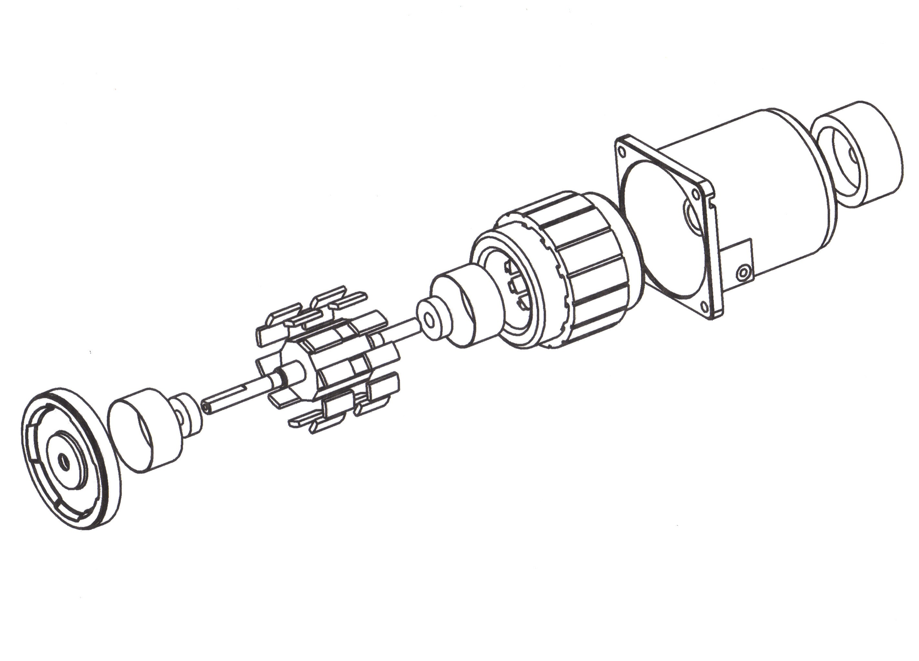
Exploded view of PM Brushless motor

Slide 4
Servo motors with and without housings or frames
Two examples of frameless motors with exposed stator laminations
Stator fitted inside extruded aluminum housing

Slide 5
Both categories of machine components contribute to mechanical design issues
Electro-magnetic vibrations
Rotor balance
Bearing systems
Motor mounting & connections
Windage & cooling fans

Slide 6
Sources of mechanical excitation forces causing structure born and air born noise
Mechanical:
Rotor dynamic eccentricity
Stator bore eccentricity or elliptical
Mounting & coupling miss-alignment
Air flow over or through machine
Broken rotor bars
Electro-magnetic:
Magneto-striction in electrical steel laminations
Harmonics from windings, saturation and slotting
Broken rotor bars
PWM voltage chopping sometimes causes
noise from torque pulsations
Radial force waves from rotor deformation

Slide 7
Motor housing frames & end frames
The stator air-gap diameter after fitted into housing frame needs to be as concentric to the end frame pilot diameters as is possible.
End frame diameters need to be as concentric as possible to the bearing bores. Bets if machined the same set up.
Rotor O.D. should be as concentric to shaft bearing diameters as economically possibly.
Rotor should be balanced per specs consistent with rated rpm.
The purpose of the above points is to avoid eccentric air-gaps to reduce noise & vibration plus unbalanced radial shaft loads.
Avoid broken rotor bars in AC Induction machines.

Slide 8
Bearing designs
Anti-friction bearing are arguably required
Bearing inner races must be a press fit on the shaft
Bearings must be preloaded to remove all radial looseness
Axial springs are required to sustain preload if shaft expands
Outer races should be loose fit (per ABEC class standards)
Output shaft bearing should be axially clamped
Spring loaded floating bearing might require radial dampening O-rings over outer race in bearing frame.

Slide 9
Radial electro-magnetic forces on stator causes noisy stator deflections for PMSM, SR & RSM
Radial deflections of stator yoke caused by natural frequencies of rotor. Sometime most noisy during startup.
Radial deflection caused by radial attracting forces on salient poles.
Design solutions:
Increase shaft diameter
Decrease bearing spread
Thicken stator yoke
Increase air gap width

Slide 10
How to calculate stator vibration modes for AC induction machines

Slide 11
Any loose components must be avoided
Stators windings must be restrained from vibration
Vacuum varnish or epoxy encapsulated
End turns to be laced or mechanical supported on large machines
Large machines with long open slots might require steel slot wedges
PM rotor magnets often require retention using sleeves or wraps
IM rotor bars must be restrained from vibration else they will fail
IM rotor cores are frequently skewed about one stator slot
Bearings must be axially preloaded to prevent looseness
Rotating bearing races are bet press fitted to shaft
Output shaft bearing should have outer race restrained
Best shaft bearing choices: anti-friction, magnetic, hydrostatic or foil

Slide 12
Bearing problems for inverter fed electric machines
Discharge current paths
SKF
PWM motor drives frequently cause early anti-friction earing failure

Slide 13
Solutions for bearing race fretting from PWM
1- Use special insulated ball bearings such as (SKF ISOCOAT)
2- Use shaft grounding rings such as (AUGIS-SGR)
3- Add induction line filters between motor & inverter

Slide 14
Stator core assembly into frames
Laminated stator cores are frequently shrink fitted into frames, cast iron , steel or aluminum.
Large shrink fits result in large radial compression stresses on stator core
The result can be an unwanted increases in iron losses
Suggestions:
Use very light interference fits and add anti-rotation pins or set screws in center of core & frame junction.
Use open frame designs with bearing frames registration on either stator core OD or ID.
Loctite type products can be used on smaller machines
Larger machines use keys between frame ID and core OD

Slide 15
Electric machine acoustic studies
Three principal sources of audible noise:
Windage, Magnetic & Mechanical
Motor audible noise scales of comparison & measurement:
Sound power & Sound Pressure (Study elsewhere)
The dBA scale is said to best equal human ear response
Sound waves and noise energy generated from windage & magnetics are excited and amplified by the mechanical structure. (Including the frame the machine is mounted to)
Magnetic & mechanical are structural noises
Windage noise is said to be air-born even though all noise become air-born in order to reach the human ear.

Slide 16
Windage noise produced by electric machines
Sound propagation from windage can be reduced by:
Increase size of inlets & outlets
Perforated air inlets & outlets
Non-symmetrical fan blade spacing
Increase air-gap between rotor & stator
Use totally enclosed air to air or air to liquid heat exchanger (only practical with large machines)
Other than trial & error testing, extensive FEA analysis of different design using computational fluid dynamics simulation software (CFD) are suggested for windage noise suppression designs of electric machines

Slide 17
Magnetic noise sources in electrical machines
Air-gap flux is not uniform because of superimposed harmonic fields
Resulting air-gap MMF waves cause radial forces on the stator core & tangential forces on the stator teeth
Amplification results at yoke & teeth natural frequencies
Teeth natural frequency:
Core natural frequency:

Slide 18
Magnetic forces on stator core

Slide 19
Reduction of noise in electric machines
Insert magnetic wedges into slot openings
Add slight taper to stator teeth
Increase core length
Adjust stator slot depth and stator yoke
Adjust stator slot vs. rotor bar combinations

Slide 20
Motor audible noise resources
Proceedings of NCAD2008 NoiseCon2008-ASME NCAD July 28-30, 2008, Dearborn, Michigan,

Slide 21
Title

