Slide 1
Electric Machine Design Course
Electric Machine Cooling Strategies
Lecture # 34

Slide 2
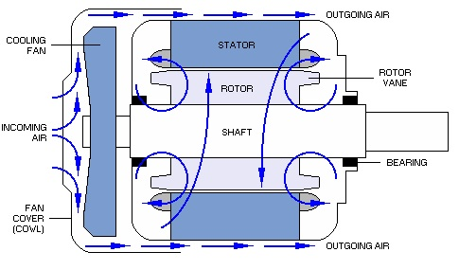
Cooling paths for shaft mounted fans

Slide 3
Large stator with cooling passages

Slide 4
Stator core vent plates

Slide 5
Thermal conductivity of various materials

Slide 6
Machine cooling media options

Slide 7
Examples of stator liquid jackets

Slide 8
Stator spiral liquid sleeve

Slide 9
External cooling fans & External cooling fins

Slide 10
Classes of IEC electric motor enclosures

Slide 11
Extruded fins for motor frame cooling
Axial fins on frame for either vertical convection cooling or forced axial
fan cooling
Is a combination cooling fin design possible?
Concentric-radial
frame fins suitable
for horizontal cooling

Slide 12
Convection cooling of motor frame

Slide 13
Motor frame fins for cooling designs
Test data provided
By Erland Persson

Slide 14
Stator winding temperature monitoring
Thermocouples or RTDs for temperature measurements
Poor practice:
On coil surface
On stator core
On any taped areas
Single sensor
Good practice:
One in slot
One inside end turns

Slide 15
Cooling a large machine

Slide 16
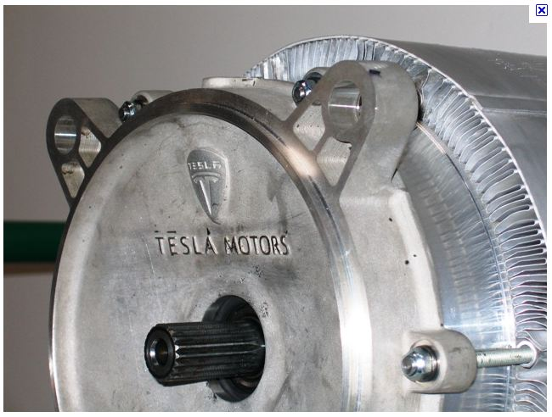
Special low cost cooling fin design

Slide 17
Stator cooling ducts with forced air cooling

Slide 18
Internal rotor & stator cooling ducts
General Electric

Slide 19
Internal shaft mounted fan cooling

Slide 20
Cooling zones in rotors & stators fo
Large GE generator cooling paths

Slide 21
Temperature rise vs time for AC IM traction machine with internal spray cooling

Slide 22
Title

Slide 23
Title

