Slide 1
Electric Machine Design Course
Thermal Design Considerations
for Electric Machines
Lecture # 33

Slide 2
Importance of electric machine cooling
and thermal monitoring during operation
Case for electric machine cooling:
Increase torque & power density
Prevent magnet de-magnetization
Maximize electrical insulation life
Identify pending rotor or stator failure
Prevention of exceeding agency limits
Electric machine cooling options:
Frame natural convection
Frame & motor mount conduction
Radiation from motor frame & brackets
Internal-external forced air cooling
Internal liquid cooling

Slide 3
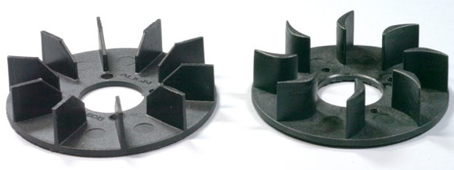
Centrifugal fan designs
Bi-directional Uni-directional
(quiet & efficient)

Slide 4
THERMAL CONDUCTIVITY
OF COMMON MATERIALS

Slide 5
VENT PLATES IN CORES FOR COOLING

Slide 6
Copper rotor with cooling vents
Indar Electric
Cooling =vents in rotor & stator cores shortens the thermal diffusion path lengths

Slide 7
Stator cooling circuit with cooling vents in cores
Indar Electric

Slide 8
Forced air & liquid cooling

Slide 9
Stator encapsulation using thermal conducting materials
Finished stator (without varnish) Stator encapsulation using thermal
fitted or shrunk into motor frame conductive compounds with fillers

Slide 10
Thermal circuit of induction machines

Slide 11
Nodal Network for thermal lumped parameter temperature rise solution
Motor-Cad

Slide 12
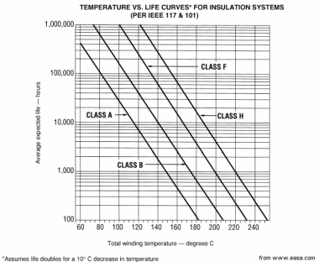
Insulation service life vs. operating temperature
100 Deg C
114 yr Life
140 Deg C
6.8 yr Life
IEEE 101 & 117

Slide 13
Machine thermal condition determines torque density

Slide 14
Thermal Resistance of electric machines
Thermal resistance = ^{O}C/W is measured or calculated
Used to predict temperature rise at different loads
Temp. rise = Watts (total losses) x thermal resistance
Two values provided, winding & frame surface
Highest temperature usually in phase winding end turns.
(Thermal resistance guidelines per NEMA ICS 16)

Slide 15
Motor constant vs. thermal resistance
K_{m} , Nm / W^{1/2}
Data plotted from many tested machines.
Motor constant (K_{m}) can easily calculated from performance design results. A reasonable estimate for thermal resistance can be determined from this plot from actual test data.
See next slide for example of a thermal node matrix for a lumped parameter thermal calculation to more accurately predict thermals
Deg. C / Watt

Slide 16
Thermal model of an AC Induction machine
Dr. G. Kylander

Slide 17
Ohmic losses vs copper resistance
I² R losses in windings directly proportional to
winding temperature (Copper or Aluminum)
Copper resistivity according to the formula:
ρ = ρ₂₀[1 + α (T – 20)] ohm-m
For Cu, ρ₂₀ = 1.728 × 10⁻⁸
For Al, ρ₂₀ = 2.65 × 10⁻⁸
α = 0.00393/°C (Cu) & 0.006/°C (Al)
A 50°C rise results in ~20% increase in I² R = W
A 100°C rise results in ~40% increase in I² R = W
For Aluminum, 100°C rise results in ~70% increase

Slide 18
Performance vs. permanent magnet temperature
Ferrite SmCo NdFeB
B_{r} / ºC change - 0.20% - 0.03% - 0.11%
H_{c} / ºC change + 0.4% - 0.2% - 0.6%
B_{r} reduction with temperature results in K_{t} & K_{e} drops
causing less torque, power & efficiency vs. ºC.
H_{c} changes with temperature results in de-magnetization issues such as maximum current limits.

Slide 19
Summary of heat transfer parameters & relationships
Prof. TJE Miller

Slide 20
Title

Slide 21
Title

Slide 22
Title

