Slide 1
Electric Machine Design Course
PM Synchronous Generator Design Principles
Lecture # 32

Slide 2
Would field & PM Synchronous Generators
Wound rotors for field excitation and good regulation requires slip rings and brushes
Requires damper windings on rotors
Used in many power generator plants all over the world.
PMSY generators with SPM or IPM magnet rotors are robust and relaible
Voltage regulation choices:
Diode rectification plus down-chopper
Active transistor rectification boost

Slide 3
Synchronous generators output frequency vs. RPM
Synchronous speed = 120 f /2p
Where poles = 2p
Output voltage proportional to rpm
Output frequency proportional:
Number of poles
RPM
RPM control for voltage regulation
(Seldom used)
For DCV regulated output:
Diode bridge rectification &
down chopper regulation
For ACV regulated output:
Active transistor rectification
and boost output voltage for regulation.

Slide 4
SPM & IPM Synchronous Generators
SPM (surface mounted magnets)
- Best choice for linearity (Minimum voltage drop/Amp
- Magnets on poles likely with require O.D. mechanical retention, such as a sleeve or fiber wrap in tension
IPM (interior mounted pole magnets)
- Best choice for short circuit fault protection
- Magnets are self contained by rotor lamination
- Output voltage drop with load current which lowers output powder density

Slide 5
PM synchronous generator configurations
Inside rotor with magnets configured for SPM or IPM
- SPM requires OD magnet retention
Outside rotor with magnets inside rotor cup easily retained. This cup can be deep drawn with flux ring
on OD to increase rotor yoke cross section
Axial flux configurations with natural non-magnetic retention of magnets on rotor OD
Rotor-Stator-Rotor or Stator-Rotor-Stator types

Slide 6
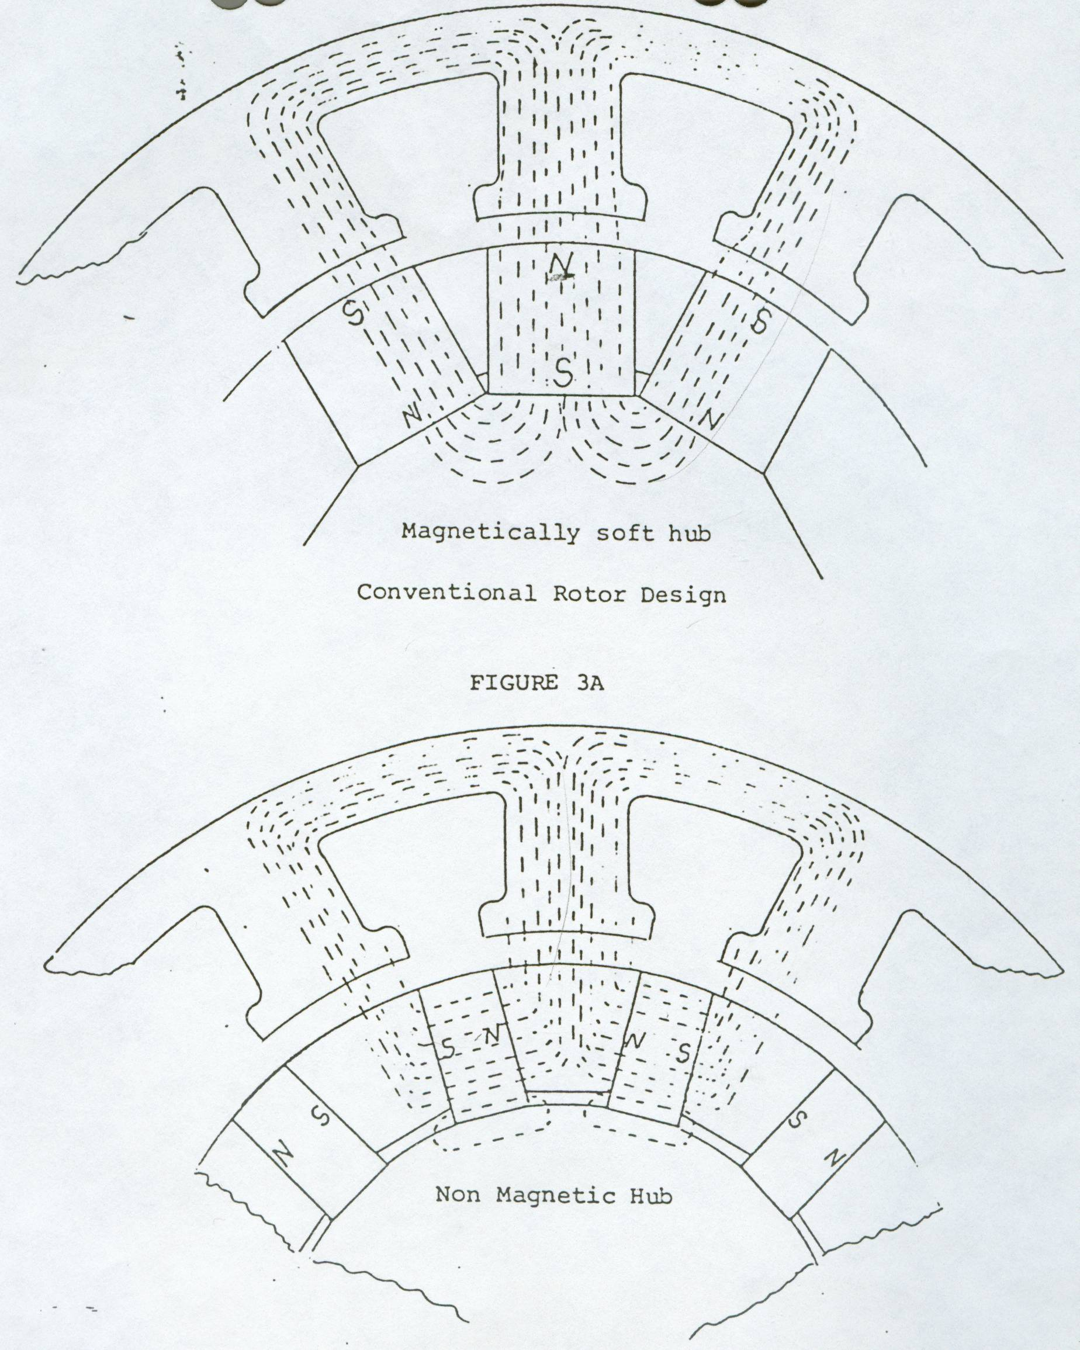
Two common aircraft type generator configurations
Surface mounted magnets on rotor OD
Low voltage droop with current load
Interior type rotor with spoke mounted rotor magnets with soft iron pole pieces between the magnets
High winding fault tolerance
Non-linear output voltage

Slide 7
Examples of alternators & generators
GE & Sundstrand
SR hi-speed unit

Slide 8
Two types of PM generators
1-Surface mounted rotor magnet configuration
Best choice for minimum voltage droop
as function of current.
(due to reduction of flux linkage)
2-Interior mounted rotor magnet configuration
Best choice for short circuit fault protection
but exhibits lower machine power density

Slide 9
Three mechanical PMSY generator configuration categories
Outside rotor magnets require retention to survive forces
Inside rotor magnets usually does not require extra retention
Axial flux machines with rotating magnets are easily retained with exterior non-magnetic retention sleeves or rings outside of magnetic circuit)
Axial flux configurations:
a- Rotor-Stator type
b- Rotor-Stator-Rotor type
c- Stator-Rotor-Stator type

Slide 10
PM Synchronous Generator Power Curve
Output E
Voltage
W Constant Output Power (low speed)
Hi-Speed Power Curve
Output Current A

Slide 11
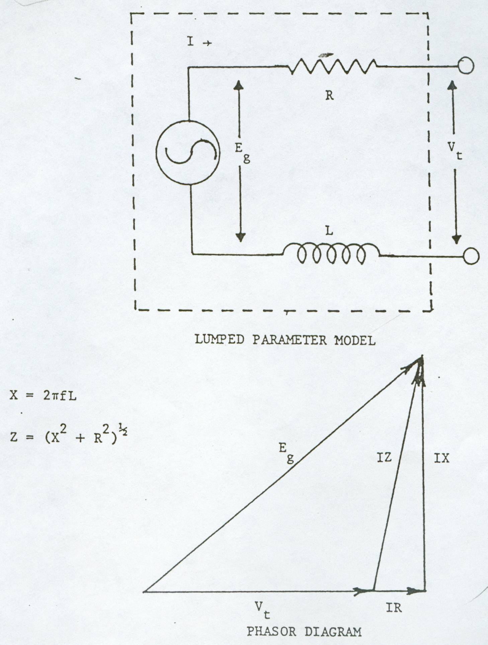
Permanent Magnet AC Generator characteristics
E_{g} = 4.4 x 10^-8 N 2p flux f (ϕ)
E_{g} (Vrms)= Open circuit output voltage
V_{t} = voltage across resistive-inductive load
X = inductive reactance (in ohms)
Z = winding impedance
N = number turns per coil
2p = number poles per phase
Flux = lines per pole
F = Hz or frequency (rpm dependent)
Gamma = angle between E_{g} & V_{t}
V_{d} = (3 √2 / π) E_{g}
rectified DC voltage from generator
@ no load or times V_{t} @ full load.

Slide 12
AC Voltage regulation with diode rectifier
Mechanical input power from prime mover
Diode
rectifier
Voltage source inverter
Synchronous
Generator (PM)
or wound field
Load

Slide 13
Permanent-Magnet Synchronous Generator Regulation with Diode Rectification
Synchronous
Generator (PM)
or wound field
DC rectified voltage varies with input rpm
DC chopping is required
for regulation
Inverter is required to convert back to AC with controlled frequency
V_{d}

Slide 14
Permanent-Magnet Synchronous Generator Theory
Load types: Open Circuit, Short Circuit, Infinite Bus (grid), Diode Rectifier, passive Impedance & Active Rectifier (transistors) For Diode rectifier with down chopper for regulation the EMF is designed to be 25% to 50% higher the the regulated DC voltage. For active transistor rectification-voltage regulation, the EMF is designed to be 25% to 50% lower than the regulated DC voltage. (sometimes known as a boost regulator) SPM generators exhibit very little voltage drop with load. IPM generators can exhibit considerable voltage drop with load PM motors generate if commutation is 180 deg from motoring

Slide 15
PMG Synchronous Machine Theory
Normal values δ=30°andcos φ=09 lagging:
Voltage regulation curves
with lagging P.F.
For a more rigorous discussion of PMG performance connected to different load types see chapter 9 in ISBN 978-0-9840687-0-8
Dr. TJE Miller

Slide 16
Title

Slide 17
Title

Slide 18
Title

Slide 19
Title

