Slide 1
Electric Machine Design Course
Permanent Magnet Rotor Design (SPM & IPM)
Lecture # 29

Slide 2
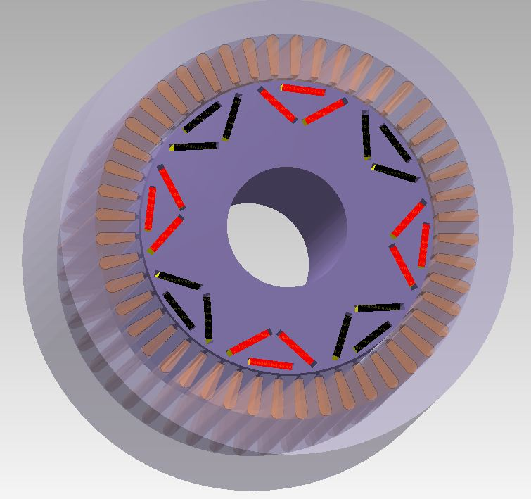
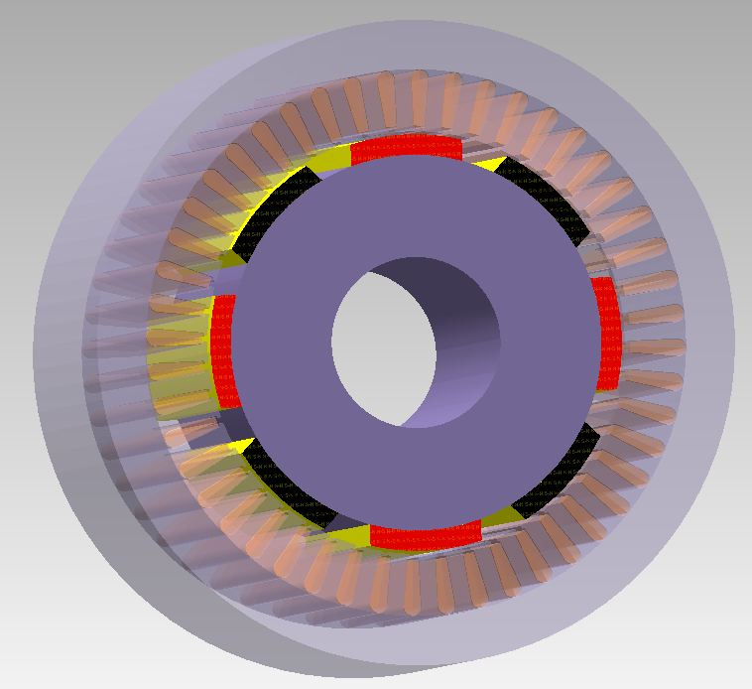
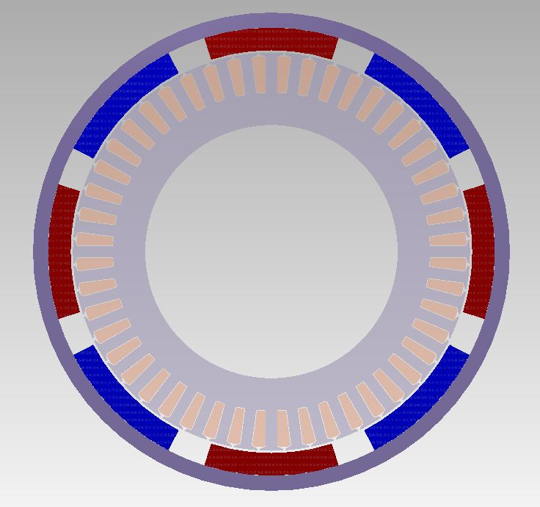
Three principle types of PM rotors
SPM Rotor
Exterior Rotor
IPM Rotor
Except for low speeds
all rotors should be
checked for balanced
Images by Infolytica

Slide 3
SPM & IPM rotor configurations

Slide 4
Exterior rotor design guidelines
Applications where high inertia is a plus like fans & blowers
Hi flux magnet grades usually not suitable
Ceramic or bonded magnets, full ring or individual poles
Radial magnetization suggested for low pole numbers
Use radial or parallel magnetization for high pole numbers
Use adhesives such a Loctite or epoxies for assembly
Additional retention usually not required.
Magnets can be pre-magnetized or magnetized after ass’y.
Yoke must be magnetic & can be designed with an inside or and outside flange for mounting

Slide 5
IPM (spoke type) rotor designs
Spoke type IPM rotors utilize low grade magnets such as bonded rare earth or ceramic.

Slide 6
SPM rotor design guidelines
Used for servos & generators for high performance
Rare earth magnets best suited SPM rotors
Bonded, molded or sintered magnets are most cost effective
Full rings, arcs or bread-loaf magnets can be used
Magnets can be pre-magnetized or magnetized after ass’y
Magnetization: radial for rings & parallel for separate poles
Laminated cores might be required to reduce eddy currents
Use adhesives such a Loctite or epoxies for assembly
Magnet retention is required to withstand centrifugal forces at speeds or against shock forces in some applications

Slide 7
IPM rotor design guidelines
Popular for traction where wide range constant power is required
Requires laminated cores (although sintered parts are possible)
Magnet grades can be ceramic or rare earth or combination
Can be designed with saliency for additional reluctance torque
Magnet retention is almost free due to internal assembly plus slot retention such as varnish or epoxy to prevent magnet motion
Magnets are best pre-magnetized with easy assembly
Rotors can easily be step skewed in sections of magnet length
IPM designs are quite flexible with many configuration choices
such as V, or U shaped, multi-layers and with empty slots.

Slide 8
IPM rotor configurations

Slide 9
Design criteria for IPM rotors
Configurations are generated
to optimize the two torque
components
Magnet torque in direct axis
Reluctance torque in quadrature axis

Slide 10
Torque equation for IPM machines
Torque plots vs. current for PMSM-IPM
IPM rotor configured
to maximize sum of
the reluctance and
alignment torques.
Total torque
Linear
optimum
phase
advance
(γ)
Alignment torque
Reluctance torque
Optimum phase advance angle γ

Slide 11
IPM design guidelines for critical dimensions
Design options summary for IPM rotor design are based upon achieving the highest sum of the two torque components per amp over operating range
Balance between “Web”
and included magnet pole angle, “BetaM”.
Increasing Web reduces
flux unless hq is increased which allows increase in
magnet width. (more flux)
Multiple magnet layers increases Saliency ratio.
Magnets can be thinner than with SPMs
Bridge must be kept to minimum & not overstressed
ORNL

Slide 12
Ceramic magnet rotor with flux focusing soft iron pole pieces

Slide 13
Cogging torque reduction (PM rotors)
Patent
6900443

Slide 14
Skewing magnet segments per pole
Step skewing of pole magnets improves sine
back EMF shape and reduces cogging torque
(Stator cores can also be skewed one slot max.)

Slide 15
Initial PM brushless rotor design process
Machine sizing is assumed to be completed given the following selections:
- Pole, slot & phase selection, IPM, SPM or exterior rotor type.
- Initial estimate of rotor (stator OD given) plus estimated air gap.
- Cooling method and performance spec in hand
- Supply voltage & current control method, trapezoid, hysteresis or I_{d} & I_{q}
First step is to estimate the effective rotor flux provided by the magnets
Final rotor flux values, leakage and distribution come from FEA analysis
Initial flux estimate is essential to proceed with stator design.
The working load line of the magnets is first estimated and plotted as the permeance coefficient (on the magnet B-H curve (from manufacturer).
Permeance Coefficient (Pc) – Known as the load-line or B/H or
"operating slope" of the magnets
Ignoring flux leakage or stator slotting effects Pc = L_{m}/g
Where L_{m} = magnet thickness & g = magnetic air gap length

Slide 16
Air-gap thickness & Magnet thickness
Air gap thickness depends upon manufacturing tolerances.
Core of stator is not usually machined or ground
SPM rotor can have stack up tolerances from magnets
If a magnet containment sleeve is required the magnetic gap must
be increased to accommodate the sleeve thickness
The magnetic open circuit load line (the permeance coefficient)
is the ratio of the magnet thickness to the magnetic air gap.
The useful gap flux (B_{m}) is highly dependent upon this load line.
The peak de-mag phase current is limited by this load line also.
Permeance coefficient should never be less than (3) and as close
to (8) if magnet cost is permitted.
The de-mag protection is an important function to the load line.

Slide 17
Determine air gap pole flux

Slide 18
Adjust permeance coefficient due to stator slotting
Larger stators frequently utilize open slots to facilitate formed coil insertion.
Certain semi-closed stators have slot openings requiring air gap adjusting.
The effect of this for PM machines increases the effective air gap (L_{g}).
Using Carter’s coefficient (K_{c}) based upon the ratio of the slot width to the air gap length, the air gap (L_{g}) & (L_{m}) might require calibration.
This can be calculated by:
K_{c} = t_{s} / (t_{s}–γc L_{g}); γc = (S_{w}/L_{g})²/( 5+S_{w}/L_{g} ); t_{s} = πD_{s}/Q
Where Q = number stator slots
D_{s} = stator inside diameter
t_{s} = tooth pitch
S_{w}= slot opening
Use of K_{c} will increase the effective air gap to more accurately predict the magnet flux from the corrected load line. If the stator has few slots and the are not too large the accuracy is not much effected . If FEA analysis is to be used for the final design this slotting error will not be present..

Slide 19
Use of Carter Coefficient to adjust permeance coefficient

Slide 20
Special magnet pole shape for SPM rotors

Slide 21
IPM rotor examples (for traction)
Ten pole IPM, dual layer V Eight pole IPM, single layer

Slide 22
High speed rotor integrity

Slide 24
SPM rotor magnet retention
E und A
JR Hendershot

Slide 25
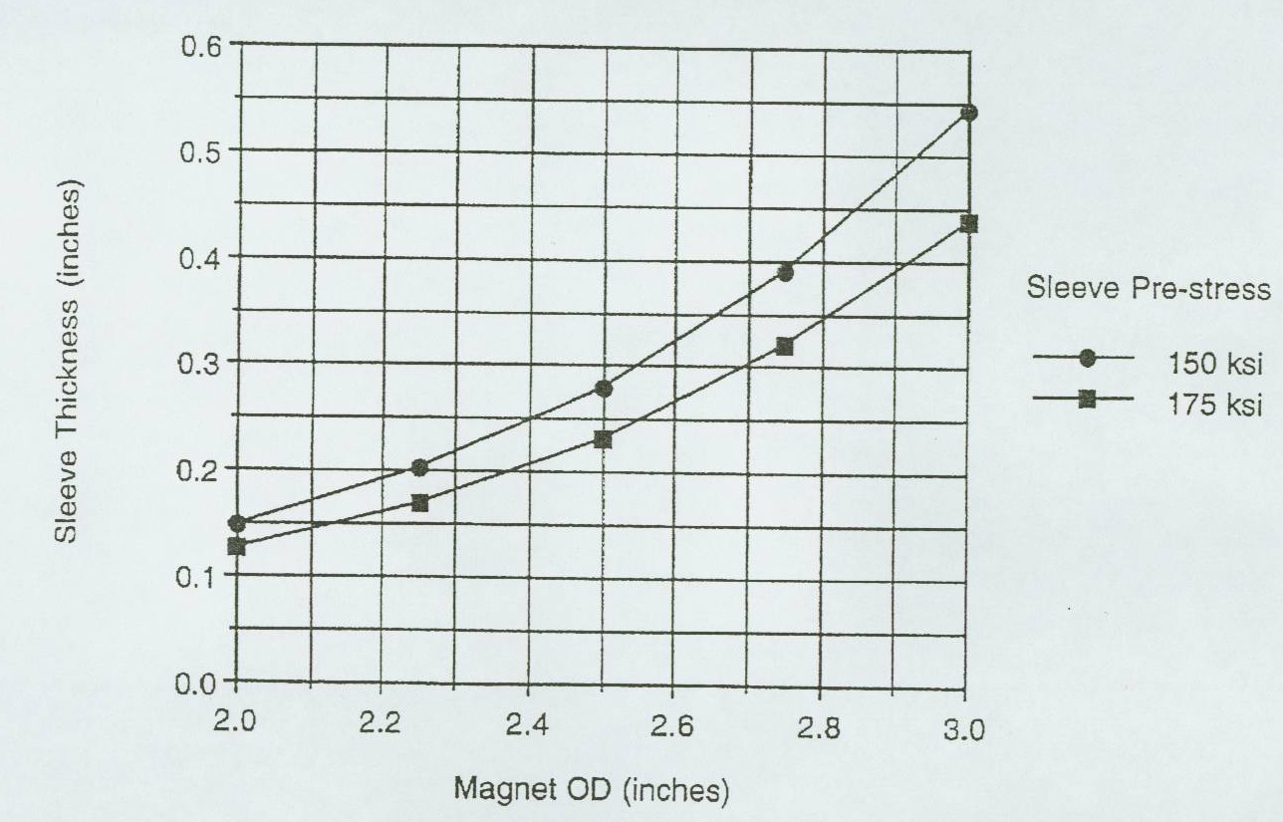
Carbon fiber retention sleeve thickness
Rotor speed
= 50 Krpm
DuPont

Slide 26
Flux distribution for SPM vs. IPM
12 slot 10 pole
PMSM
SPM
IPM

Slide 27
Rotor with Super Conducting Magnets
Super Conducting Coils
Must be maintained at
cryogenic temperature
for continuous current flow to produce high magnetic fields
AC Induction super conducting (4) pole rotor
(by American Superconductor)

Slide 28
TITLE

Slide 29
TITLE

Slide 30
TITLE

Slide 31
TITLE

