Slide 1
Electric Machine Design Course
PM-DC Brushless and
PM-AC Synchronous Machines
Lecture # 27

Slide 2
History of PM Brushless machines
In the early 60s the Apollo space program precipitated the rapid development of brushless motors with electronic commutation using photo switches by Sperry Farragut and hall switches by Kearfott..
Many companies developed brushless products as magnets and electronics improved for the next 20 years.
By 1980 brushless DC motors became favored for the emerging computer peripheral products like printers, tape drives, floppy disc drives, hard disc drives and later CD-DVD drives.
In the mid 90s they were called PM-AC synchronous motors. The motors were not much different from their DC brushless cousins but only how they were powered with sine currents much like ac induction motors.
By the year 2000 & beyond there are many variations motors with PM rotors emerged including axial flux, slotless, IPMs as well as SPM rotor configurations for almost any application.

Slide 3
PM brushless or PMAC features
Shaft torque produced by the flux linkage from the permanent magnet rotor with stator phase conductors.
Rotor rpm is self-synchronizing to stator f with zero slip
Rotor pole angular positions estimated or measured
using either shaft mounted encoder feedback or calculated from (L_{q} & L_{d} )
(Note: L_{q} & L_{d} are nearly equal for SPM PMAC machines
Very high torque densities with 8 or more rotor poles
Stator poles generated by phase windings can be more
or less than PM rotor poles.
(IMs & RSMs must have equal poles on rotor and stator)

Slide 4
PM-DC & PM-AC Synchronous Motors & Generator Configurations
Axial Flux Configurations
R+S+R, S+R+S, R+S
Transverse Flux Topologies
Single or dual gap
Radial Flux Configurations
Inside or Outside Rotor
Surface Magnets on Rotor
IPM (internal permanent magnets)

Slide 5
Radial flux can be SPM or IPM
SPM rotor produces torque
from magnet flux linkage to
stator conductors.
IPM rotor produces torque from magnet flux linkage
plus reluctance torque.
ELEKTRONIKA CNC

Slide 6
Larger air-gap
Smaller
air-gap
Brushless
stator design typical of an
AC Induction machine

Slide 7
Axial flux machines variations

Slide 8
Halbach array magnet arrangements

Slide 9
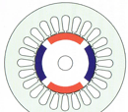
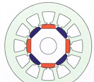
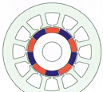
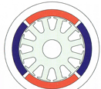
SPM Rotor Configurations
Radial with
Saliency
Bread Loaf*
Outside Rotor*
Radial Poles*
*Courtesy T.J.E. MILLER*

Slide 10
IPM Rotor Configurations
(8) Pole
Spoke IPM*
No Saliency
V (8) Pole – IPM*
FORD
V (8) Pole - IPM
Toyota Prius
*Rapid Simulation of Permanent Magnet Drives
Praveen Kumar1 Peter van Duijsen2 - Pavol Bauer

Slide 11
SPM vs. IPM PM brushless AC-DC machine comparison
SPM rotor: Surface mounted rotor permanent magnets.
Highest torque density machine possible (Perm. Coef. of 10 or more)
Highest torque/inertia ratio possible. (Important for servo motors)
Simple construction but requires shaped arc or bread loaf magnets
Highest torque linearity due to low leakage reactance of SPMs
Requires more magnet mass to resist de-mag. fields
Limited constant power range due to field weakening difficulties
Many applications require magnet retention sleeves
IPM rotor: Interior fitted rotor permanent magnets.
With extra reluctance torque component, magnet mass is reduced
Capable of 8 to 10 to 1 constant power ratio
Magnets slabs are lowest in cost due to minimum finish grinding
Magnet retentions is automatic due to being internal to the rotor lamination. Some leakage flux is present through retention webs
Rotor fabrication somewhat more complex but can easily be tooled
Magnets can be thinner due to protection by being inside soft steel laminated poles.
Control more complex but is justified by performance gains

Slide 12
IPM torque
Two torque components
Alignment (from magnets)
Reluctance (from saliency)
Gamma:
(phase advance angle)
Optimized for maximum sum of alignment & reluctance torque for minimum current
at any load.
(50-50 split not uncommon)
Best design when back emf is higher than the DC rail voltage at max. rpm.
Requires careful analysis
using a good simulation tool.
Prof. TJE Miller
= Gamma

Slide 13
Stator requirement for PM rotor machines
A standard stator cores and phase windings from an AC induction machine can be used for a PMSM or PM brushless machine
The performance or cost issues frequently dictates special stator core and winding feature:
High stator phase slot fills to maximize efficiency
Provisions to reduce high frequency impedance losses
Special winding patterns and multiple phase connections
Special lamination and core designs
Outside rotor and axial flux are requirements of PM designs not common with AC induction machines.

Slide 14
Pole number vs. torque density
Stator laminations
200 mm O.D.
(4) Pole (8) Pole
I.D. = 115 mm I.D. = 132 mm
15% rotor
radius increase
(4) to (8) poles
Increasing pole numbers increases torque density
Stator thickness reduction can be used for larger
rotor or smaller stator OD with same rotor

Slide 15
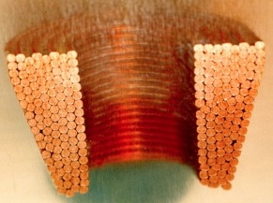
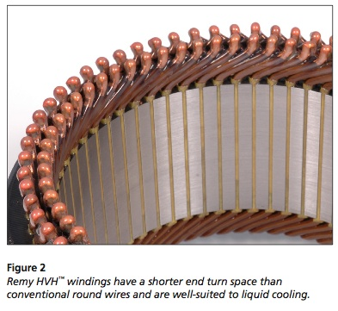
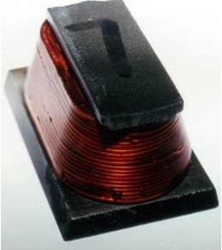
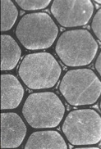
Phase coil examples of high slot fill designs
Remy
Ford Stator
Rectangular wire
Automatic machine inserted (65-70% fill)
Die formed
conductors

Slide 16
Title

Slide 17
Title

Slide 18
Title

