Slide 1
Electric Machine Design Course
Rotor Design of Reluctance Synchronous Machines
Lecture # 25

Slide 2
RSM rotor design goals
Initial assumptions:
RSM stator same as 4, 6 ort 8 pole A-synchronous machine
Rotor to stator air gaps similar to AC Induction
Driven with software modified three phase inverters
For successful RSM designs the Lq / Ld should be 5, 6, 7 or higher
Power factor must be greater than 0.8 or 0.9
Rotor construction must be robust for rpm stability
JRH thanks Prof Tom
Lipo for his teaching

Slide 3
RSM rotor design guidelines
Rotor saliency must be optimized to maximize inductance ratio
Rotor can be axial or radial laminated
Maximum saliency produced by flux guides & flux barriers
Saliency ratio determines max & min inductances L_{d} & L_{q}
Output power & torque proportional to inductance ratio
To compete with other two motor technologies L_{d} / L_{q} > (7)
Final rotor design must be robust enough to withstand all
forces on rotor caused by producing torque without damage

Slide 4
More rotor design hints for RSM rotors
Use of radial flux carriers & flux barriers as magnetic flux guides to improve saliency and inductance ratio of rotor in stator circuit.
a- Transverse or radial laminations can make up the rotor soft iron pole sections for high inductance
b- Alternate laminating of the rotor iron pole sections involves axial laminations punched from stator bore
c- Optimize number of flux guides and thickness ratio
d- Shaping of flux guides
e- Minimize number of flux carrier support webs.

Slide 5
RSM rotor d & q Pole axes
Standard AC IM stator
RSM rotor with alternate layers
of flux carriers
& flux barriers
q
d
Desired d/q inductance & saliency ratio greater than 7
Shaft can be magnetic or non-magnetic

Slide 6
Typically two rotor lamination choices
Radial laminated rotor Radial barriers & carriers
Axially laminated rotor Radial barriers & carriers
Permanent magnet material can be used
to perform as non-magnetic flux barriers.

Slide 7
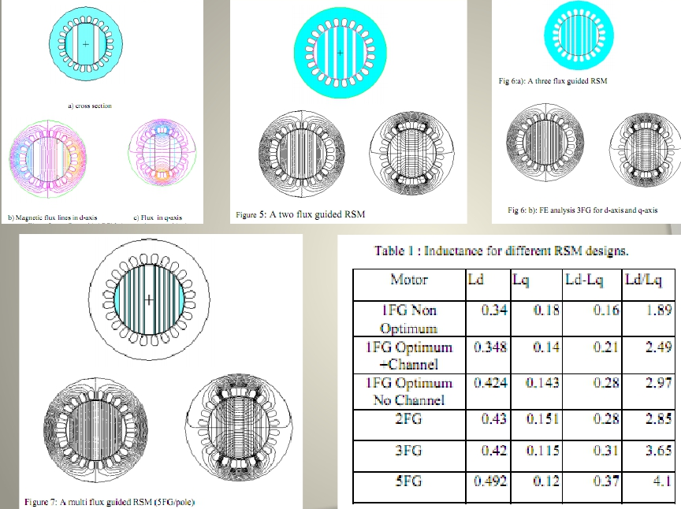
Sample RSM rotor configurations with saliency ratios

Slide 8
RSM rotor configurations
Countless rotor carrier/barrier variations are possible

Slide 9
Radially laminated RSM rotor principles

Slide 10
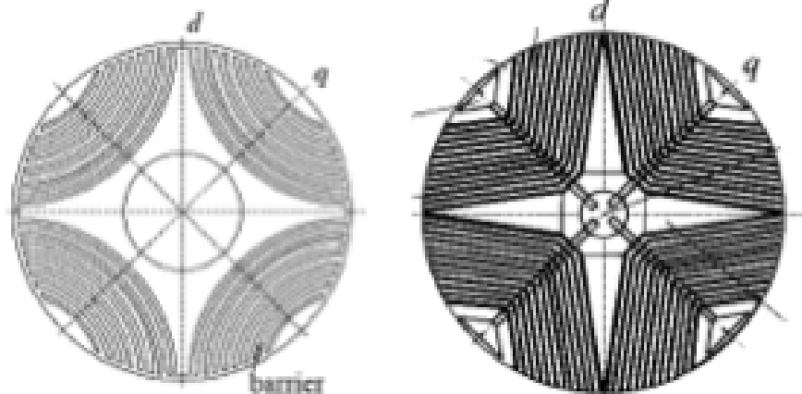
(4) pole RSM rotor designs
The flux “barriers” or magnetic flux insulators produce
anisotropy which results in the forming of poles in the rotor.
The resulting saliency produces the poles which are the
preferred magnetic flux paths known as the rotor poles.
Furnished by Prof. Valeria Hrabovcova, & Josef Mihok, University of Zilina

Slide 11
RSM power factor P.F. vs. saliency ratio K_{sal}
P.F.
K_{sa}

Slide 12
(K) saturation factors for Inductance, open circuit vs. saturated for q & d axes
Saturation factors
vs. inverter voltage

Slide 13
Typical RSM rotor configuration showing necessary sections.
Flux barriers
Flux carriers
Carrier support ribs

Slide 14
Design of flux carriers & flux barriers
Flux Barrier
Flux Carrier
RSM (4) pole rotor example

Slide 15
Rotor barrier insulation ratio (K_{w}) A comparison of different RSM rotor geometry designs, is useful to define the ratio of the widths of the barriers by the widths of the carriers: W_{barrier}= sum of thickness of flux barriers W_{carrier}= sum of thickness of flux carriers If w = zero the rotor is solid If w = 1, the barriers & carriers are equal thickness

Slide 16
Saliency ratio of RSM rotors determines inductance ratio based upon the thickness of barrier to carrier
K_{sal}
t_{b} / t_{c} Thickness of barrier/carrier
Saliency ratio K_{sal} vs flux carrier / flux barrier (t_{b} / t_{c})
Ideal t_{b} / t_{c} would seem to be 0.5 for K_{sal} = 10
Based upon FEA analysis conducted by Gary Horst for University of Wisconsin

Slide 17
Title

