Slide 1
Electric Machine Design Course
Reluctance Synchronous Motors
(IM stator & Salient Pole Rotor)
Lecture # 23

Slide 2
Why all the recent fuss surrounding RSMs?
Principle reason is the rising cost and limited availability of NEO magnets
Second reason is the introduction of a complete RSM product line bay a major world motor manufacturer, ABB. Their new product line, “SynRM” offers a power range from 17 to 350 KW.
Some definite advantages and features:
Much lower cost than PM machines
Almost zero rotor losses (higher torque density than IMs)
Simple manufacturing process using existing infrastructure
Good field weakening capabilities for wide power range
Synchronous operating behavior with zero slip
Historical success has been limited
Previous rotor designs did not produce sufficient saliency
Rotor configurations were not robust enough against forces

Slide 3
Brushless motors with no magnets
SRM
RSM
Switched Reluctance Reluctance Synchronous
New Mfg. technology
Special stator windings
Robust rotor (no conductors)
Difficult noise control
Special Inverter & control
Standard AC motor/stator
Standard AC phase windings
Simple rotor (no conductors)
Normal induction motor noise
Uses standard AC inverters

Slide 4
History of RSM technology development
RSM’s of the 60s & 70s utilized starting cages

Slide 5
Reluctance Synchronous, four pole motor, using standard AC induction stator
AC Induction type stator & standard
(3) ph. windings &
AC inverter driven
Rotor punching yields
flux barriers/carriers
for high L_{q} / L_{d} ratios

Slide 6
Pros & Cons of Reluctance Synchronous Machines
Prof. T Jahns

Slide 7
ABB RSM vs. AC Induction
ABB photo of original IM rotor vs. their new RSM rotor
RSM rotor requires no cooling fan blades because the RSM rotor produces zero losses
Rotor designs for RSMs must exhibit saliency of the poles
to produce comparable performance to IMs
Identical stator punched lamination
and core stacking
RSM requires a new rotor punching
and similar core stacking as IM
IM
RSM

Slide 8
Motor losses in AC Induction vs. SynRM machines

Slide 9
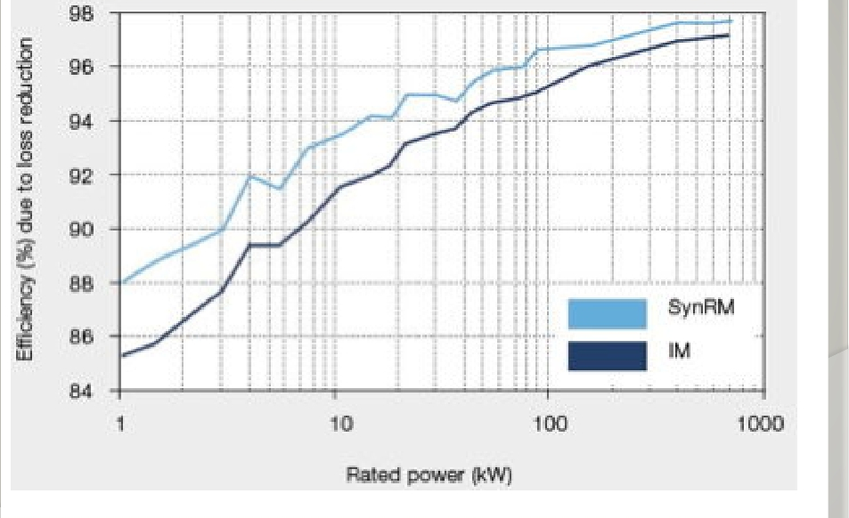
Efficiency comparison RSM (SynRM) to an IM
RSM rotors produces
zero ohmic losses
Data from ABB

Slide 10
Motor type comparison for vehicle traction
Very little information is available to report on by 2012 relating to the relative performance advantages of each of the machines shown for use in vehicle traction.
Some obvious points:
IPMs currently dominate traction
Reluctance types use no magnets
SRMs are noisy with large torque ripple requiring unique inverters
SRMs are simple and low cost
IMs are well known but rotors are hot because of Omic losses.

Slide 11
Thermal comparison of RSMs to IMs
A comparison was conducted for an IM and
RSM in Italy in 2008 with both motors using
the same stator but with different rotors.
IM Torque =
RSM Torque =
Both motors have about the same air-gap flux density & Ohmic stator losses (because they both use the same stator)
Due mainly to the zero rotor losses in the RSM machine, the RSM torque rating was 17% higher than the IM version and was validated by testing.
There was no data in the paper on the saliency ration of the RSM however.
Aldo Boglietti, Senior member IEEE, Michele Pastorelli Department of Electrical Engineering
^{Politecnico di Torino}

Slide 12
(8) pole RSM and (6) pole SRM cross sections

Slide 13
SRM vs RSM (Salient pole machines)
(3) phase machines
(4) Pole Switched Reluctance (4) Pole Reluctance Synchronous

Slide 14
Salient Pole Motor Comparison SRM vs RSM
Switched Reluctance
Reluctance Synchronous
New Mfg. technology
Special stator windings
Robust rotor (no conductors)
Difficult noise control
Special Inverter & control
Higher frequencies
Requires small air gaps
Standard AC motor/stator
Standard AC phase windings
Simple rotor (no conductors)
Normal induction motor noise
Uses standard AC inverters
Normal frequencies
Requires small air gaps

Slide 15
Inverter comparison for RSM & SRM
Classic SRM inverter with parallel connected phases between the DC rails
Classis inverter for either
IM or RSM Wye connected
with neutral connected phases
PH1 PH 2 PH 3

Slide 16
Historical dissatisfaction with RSMs
As stated earlier, this RSM machine has been around for many years
The power factor and efficiency has never been high enough
The current high price of permanent magnets forces us to reconsider this simple machine type to determine if performance can be improved
The key to the improvements in efficiency and power factor lies in the inductance ratio or the saliency ratio in the d & q axes.
The potential advantages of using current inverter technology and current Induction stators, frames & mfg. infrastructure with a new rotor design is very attractive for a development project with a potentially big payoff if successful.

Slide 17
Mechanical stability of RSM rotor
The high saliency ratio requirement of any new rotor works against the integrity of the rotor against torque forces, radial forces and shock loads
To provide saliency the rotor pole must be arranged in layers of magnetic flux carriers and flux barriers.
In order to accomplish the required saliency the soft iron magnetic flux carriers must be held together with support ribs between them. The need to be thick to provide carrier stability against the forces mentioned above.
This rib thickness decreases the
saliency of the poles and allows
precious flux leakage in the wrong
axis
Support RIBS

Slide 18
Title

