Slide 1
Electric Machine Design Course
Performance Calculations for
Inverter Fed Induction Machines
Lecture # 22

Slide 2
Phasor diagram for single phase of an IM.
The stator speed and the rotor speed are not the same based upon the slip which causes by the load.
Prof. Mahmound Riaz
University of Minnesota

Slide 3
Torque vs. Speed function of AC voltage & frequency
Prof. TJE Miller

Slide 4
AC Induction torque vs. rpm plot @ constant volts & frequency
Prof. TJE Miller

Slide 5
IM performance can be studied using three methods:
1-Equivalent Circuit
2-Vector Diagram (from equivalent circuit)
3-Motor Circle Diagram
(See Polyphase Induction Motors,
Paul Cochran ISBN 0-8247-8043-4)
Prof. Mahmoud Riaz

Slide 6
Equivalent circuit IM analysis method
The fastest method to calculate IM performance is arguably the equivalent circuit method but all the E.C. parameters must be measured or calculated. (Reactances are difficult)
In lecture #18 the rotor & stator resistance calculations were outlined
The applied supply voltage is always a given in the specification
The frequency choices are based upon the IM pole number, slip & RPM
This leaves us with the magnetizing current calculations for a given load point along with the three inductance parameters to determine.

Slide 7
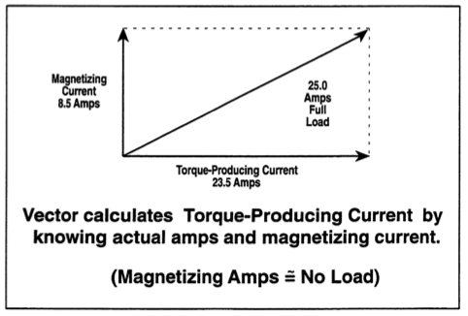
Stator phase current & vector parts required for IM flux vector control
Total Phase Current
Magnetizing
Current
Torque producing current
Torque producing current is the vector determinate of
the phase current and magnetizing current.
(Magnetizing current required to achieve desired load point)

Slide 8
Magnetizing current Calculation
Calculate magnetizing inductance
Magnetizing MMF
Carter coefficient to account for the effective air-gap length increase due to slot opening. Usually in the range of 1-1.5 (Ref [1-4])
MMF drops along stator teeth, rotor teeth, stator core and rotor core, estimated from assigned flux density and B-H curve
Teeth saturation coefficients
Magnetizing current

Slide 9
Calculate stator leakage inductance
Calculate the leakage reactance consisting of several components by using some equations and some empirical formulas (very approximate).
q: Stator slots/pole/phase
Stator slot leakage coefficients
Stator differential leakage coefficients
Stator end leakage coefficients
Stator slot leakage reactance
Stator differential leakage reactance
Stator end leakage reactance

Slide 10
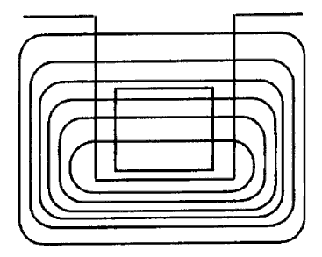
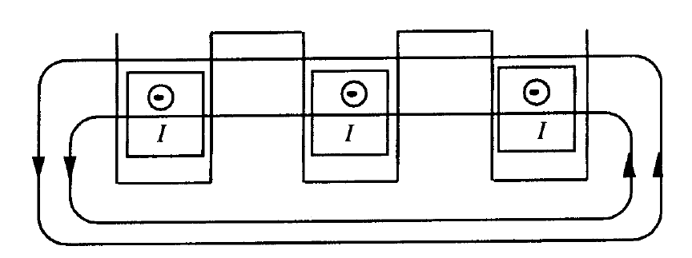
Slot leakage coefficients
Slot leakage flux in a single slot
Slot leakage flux in a phase belt
: (coil pitch) / (pole pitch)
Ref. [1] Boldea
Deeper slot, larger slot leakage reactance
Wider slot, larger slot opening, smaller leakage reactance

Slide 11
Differential leakage coefficients
The total reactance due to all harmonic fields of both stator and rotor is called differential reactance.
Differential reactance has two components: zigzag( ) and belt ( )
zigzag
belt
X_{bts}: belt leakage reactance
X_{m}: magnetizing reactance
K_{dpv}: winding factor for v^{th} harmonic
K_{sv}: saturation factor for v^{th} harmonic, can be approximated by K_{sd} in step 17
Ref. [1]
: (coil pitch) / (pole pitch)
K_{c}: Carter coefficients

Slide 12
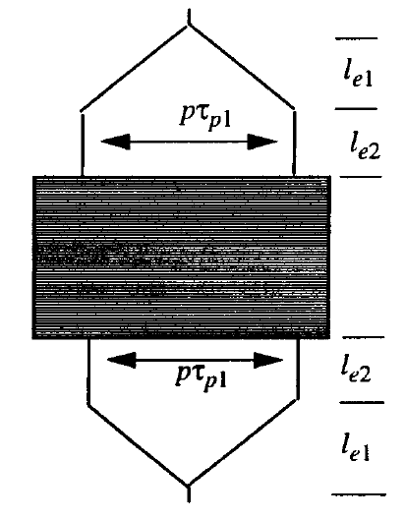
End leakage coefficients
An approximate expression
Ref. [1] Boldea
q: Stator slots/pole/phase
β: (coil pitch) / (pole pitch)
l_{end}: End connection length of a coil
L: Machine axial length

Slide 13
Calculate the leakage reactance consisting of several components by using some equations and some empirical formulas (very approximate).
Rotor differential leakage coefficients
Rotor end leakage coefficients
Skin effect coefficients

Slide 14
Rotor differential inductance
Zigzag
belt
Ref. [1] Boldea
p: Pole number
N_{r}: Number of rotor slots
τ_{r}: Rotor slot pitch

Slide 15
Rotor end leakage inductance
Rotor end-ring cross section
p: Pole number
N_{r}: Number of rotor slots
L: Machine axial length
a, b: End ring width and height
D_{re}: Rotor outer diameter
D_{er}: End-ring outer diameter
Ref. [1] Boldea

Slide 16
Calculate performance from Equivalent Circuit
now that all parameters have been estimated.
Basic torque equation for shaft torque any speed (Minus windage & friction):
(Nm)

Slide 17
Using Thevenin’s theorum for torque calculations from the equivalent circuit.
The use of Tehvenin’s theorem greatly simplifies the torque & power calculations form the equivalent circuit by leaving out the core loss term.
(see ISBN # 0-07-36009-4, page 322 for detailed discussion)
The Tehvenin IM equivalent circuit becomes:
Where there is a simple voltage divider and the impedance between terminals a & b viewed toward the source & set to zero (like a short circuit)

Slide 18
Torque formula simplified for any speed
from Thevenin’s equivalent circuit
This torque equation can be used to generate the following shaped torque vs speed curves at any fixed voltage and frequency.

Slide 19
Use of fixed frequency-voltage curves
About (5 or 6) curves are required to define the machine & inverter performance envelope for a Traction application for example
The voltage & frequency is optimized for the (5) defining points on the required torque
vs. speed plot.

