Slide 1
Electric Machine Design Course
Rotor Design for A-Synchronous Induction Machines,
Part 2
Lecture # 21

Slide 2
List of important rotor design considerations
1- Cast vs fabricated construction
2- Selection of bar number vs stator slots
3- Cage material, aluminum or copper (or other)
4- Rotor bar shape, bar to slot fit, skew and air-gap
5- Torque vs. speed requirements
6- Voltage & frequency operating range
7- Number of poles and Power Factor requirements
8- Forces on bars, end rind rings and audible noise

Slide 3
Begin IM rotor design with rotor core
The IM rotor core must be made from stacked laminations
Lowest cost when punched from hole in stator punching
First step is selection of number of rotor bars to yield high P.F.
Second step is selection of rotor bar shape for Inverter operation
Third step is to decide on rotor bar and end ring material.
(If simulation is used both Al & Cu should be compared
Do not forget to study the thermal expansion differences between the steel laminations and aluminum or copper bars & end rings.
At some diameter the end rings will need to be extended beyond the core length to allow for bending stresses on the bars to prevent shear stress on the bars at then end of the core.

Slide 4
Typical rotor punching for vector controlled IMs
Rotor slot shape for inverter driven machinesr
Semi-closed,
tapered slots,
parallel teeth

Slide 5
Lamination material and anneal condition choices
A- Semi-processed electrical steel, no core plate
B- Fully processed with core plate insulation
C- Semi-processed and annealed after punching
Color indicates material & condition
Slot & teeth configuration shown have nothing to do with material used
Larger rotor laminations are stamped with keyways.
Smaller rotor have no keyways.

Slide 6
“SLINKY” CONSTRUCTION FOR ROTOR CORE (OR STATOR CORE)

Slide 7
Rotor conductor or bar numbers for caged rotors
Past motor experts have published rules to go by,
many of which contradict each other so here are my suggestions along using the list on previous slide.
The number of rotor bars should never be equal to the number of stator slots.
Rotor bar number can be 1.2 x number of stator slots.
Rotor bar number can be 0.8 x number of stator slots
Select at least 6 rotor bars per pole (higher if possible)
Skewing reduces zig-zag losses

Slide 8
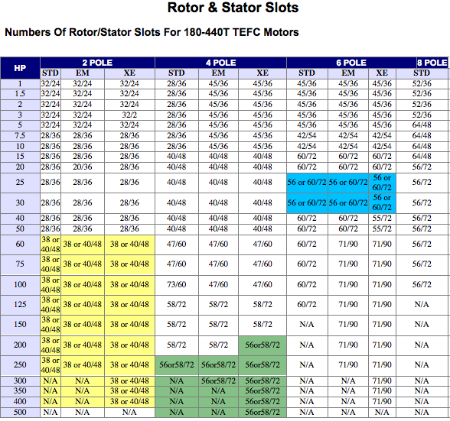
Rotor bar numbers vs. stator slots for IMs motors
List by Reliance & Baldor

Slide 9
Sanity check on number of rotor bars/slots
Stator (S₁) & rotor (S₂) combinations to avoid (LIPO Suggestions)
Poles = 2p = P
Suggested stator/rotor combinations v poles for inverter controlled machines
This furnished by
Prof. Tom Lipo

Slide 10
Historical rotor bar shapes for grid motors
Rotor bar shapes & rotor slot shapes for use with variable voltage and frequency inverters do not benefit from odd slot shapes designed for short time high rotor resistance to increase starting torque from fixed voltage and frequency from the grid.
Furthermore most rotor slots were designed for starting and efficient running with no consideration for
peak starting torques at high currents required by many traction and propulsion applications.
The rotor slots normally need to be optimized for use with a flux vector inverter in order to take advantage
of what this drive offers.
Rotor
bar shapes

Slide 11
Rotor resistance effect on Torque vs. Speed
Optimum rotor for Inverter powered machines
Constant AC voltage and Frequency
Torque
Dotted curve produced from special bar designs used for grid powered motors, not useful for inverter fed IMs
Speed

Slide 12
Variety of rotor slot shapes
Perhaps a small few of these shapes used over the years for grid powered IMs might be useful for IMs driven and controlled by Inverters.
(No guarantees because best choices require extensive analysis and testing) NEMA type A rotor slot shapes have been used successfully.
EASA

Slide 13
Rotor bar design guidelines for ASD
Position rotor bars close to rotor OD to minimize leakage reactance
Die cast rotors can use semi-open slots and cast conductors to fill slot openings with finish OD machining to size.
Tooth tip angles should be about 45 deg. to provide bar retention
Bars must be retained in slots to prevent vibration in fabricated rotors.
Seldom a problem with cast rotors
Swaging is used for bar retention
Bars can be oven brazed in slots for high speed units
Bars can be retained with vacuum applied hi-temp. adhesives
Use at least 6 bars per pole, for 4 pole and up for integral HP designs
Increase number of bars per pole with increasing power.
Use FEA analysis for final rotor bar selection for max efficiency & P. F.

Slide 14
More rotor guidelines for ASD machines
ASD (adjustable speed drives) using either constant V/Hz control or flux vector d & q axis current control.
The most dramatic improvements in inverter-fed IMs is achieved by optimizing the rotor slot & bar quantity, shape and bar material
Inverter fed IM starting conditions are very soft as compared to grid powered IM starting. This results in smaller radial loading forcing on the bars.
However the bars must be tight and not permitted to vibrate
The rotor bar vibration frequency = 2X slip(%) x f , This vibration is caused by high current forces. If the bars are loose they will work harden over time and break.
In addition, there thermal stresses in the bars due to temperature variations in each bar from the top to bottom. Example: 225 deg. C close to slot opening, 100 deg. C in center of bar and 25 deg. C in bottom of slot.

Slide 15
Rotor bar starting currents
Grid powered machines see rotor bar starting currents as high as 650% of rated current, vs. 150% of rated current for inverter driven machines.
During grid motor starting from zero rpm, this starting current flow is in the upper part of the bar close to the rotor OD. (due to the skin effect of current penetration). AS the motor increases speed the bar current is distributed down in the lower part of the bar & the frequency seen by the bar decreases (decreasing slip)
This means that the life of the bars is based upon the number of motor starts when powered by fixed voltage and frequency from the grid.
This starting situation is not such an issue with inverter fed machines because the skin effect is mitigated because of the continuous control
of voltage and frequency control. The skin effect is not a factor any more because the bars are never exposed to high frequencies causing high slip.

Slide 16
Rotor bar choices for fabricated IM rotors
A- Aluminum with hard anodize coating
B- Aluminum with no surface insulation
C- Aluminum with light anodize coating
D- Copper without insulation coating

Slide 17
IM rotor cooling issues
IM rotors produce very low iron losses due to low slip
IM rotors produce significant heating from Ohmic losses
Rotor cage requires very high current with only one turn/phase
The entire rotor is mounted in bearings with long thermal diffusion
paths from the heat sources (ohmic) through the shaft, ball bearings to the frame.
Frequently an existing rotor lamination is tempting to use even though the steel laminated teeth vs slot area were not optimized for use in many IM applications.
Either the current density comes out too high or the teeth flux density comes out too high.
Either way the IM machine rating will be limited by the rotor heating
if current density is excessive. (Greater than about 5 or 6 A/sq.-mm)

Slide 18
Cooling options for IM rotors
Small die cast AL machines have crude fan blades cast to the cage end rings to circulate cooling air. (Benefits both stator and rotor)
Special cooling systems utilizing the cage to focus circulating outside forced air cooling such as an inlet air deflector. (Slide # 217)
Cooling vents are fabricated into the rotor cores to improve direct air cooling and shorten the thermal diffusion path lengths.
The most cost effective method to cool an IM is through the use of an external blower properly ducted into the machine to cool the rotor and stator
High performance IM machines like those used for vehicle traction might require internal splash or spray cooling directly onto the rotor end rings.

Slide 19
Medium size IM showing internal cooling details
EASA

Slide 20
Rotor cooling design that benefits stator cooling
Rotor & stator cooling ducts
Stator
Rotor
Inlet air deflector

Slide 21
Forces on IM rotor during operation

Slide 22
Final comments on IM rotor designs
The leakage reactance is made up of the sum of the following:
Rotor differential leakage inductance
Rotor end leakage inductance
Current skin effects in rotor bars
These calculations can be approximately estimated by using Prof. Boldea methods.
FEA analysis (although not faster), results in more accurate performance predictions due to the difficulty in calculating leakage reactances.
If torque output vs. current is too low (assuming machine is large enough), the rotor leakage reactance is too high so rotor slot shaped or radial location must be improved (also stator slot modifications).
The rotor tooth vs slot width must be balanced for current and peak torque flux densities so if rotor resistance is too low increase slot and bar depth.
Use of thick end rings is good practice for inverter powered IMs. (Why?)

Slide 23
Cross-path resistance between adjacent rotor bars
Inverter fed IMs operating at higher speeds, produce cross-path resistances in trapezoidal shaped bars. (500 Hz & higher)
The extra rotor losses caused by cross path resistance from un-insulated bars lead to tray load losses and further discussion and analysis is beyond the scope of these lectures.(Parallel teeth permit best bar shape)
There are several IEEE articles on these studies for reference.
(IEEE 07803-0453-5/91)
“Effect of cross-path resistance between adjacent rotor bars on performance of inverter-fed high speed induction motors.”
Included in this paper is a formula for the effective rotor bar height vs. frequency is given:

Slide 24
Title

