Slide 1
ELECTRIC MOTOR DESIGN
Tutorial Lectures
Instructor:
James R Hendershot
Hendershot@ieee.org
941 266 7631
September 2012

Slide 2
Introduction to motor design lectures
(37) lectures are presented covering practical design procedures for three types of electric machines which each use the same or similar stators including cores and phase windings.
The first (15) lectures cover the topics that are common to all three machine types pertaining mostly to sizing, material selections & stators
For IMs (induction rotors) there are (7) lectures
For RSMs (reluctance synchronous rotors) there are (4) lectures
For PMSM, SPM & IPM types of PM rotors there are (6) lectures
An additional (5) lectures are added for general topics for thermal, mechanical, manufacturing and future challenges for machine design.
These lectures are intended for engineers who have a basic understanding of the theory of electric machines. This material is intended to supplement that eclectic machine theoretical background

Slide 3
Electric Machine Design Course
History & Introduction of Electric Machine Types
Lecture # 1

Slide 4
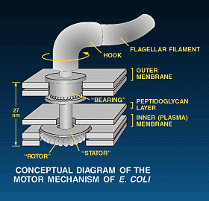
First known Electric Motor
Microscopic Bacteria Propulsion Motors
Plastic model of motor

Slide 5
Spark Museum
1312 Bay Street
Bellingham WA 98222
Tel: 360 738 3886
Early examples of electric machines and other devices
Early TESLA
AC Motor

Slide 6
From Faraday’s law of Induction (1831)
Tesla & others developed the uses
of interactions of electric currents & magnetic fields produce mechanical forces that when properly configured
produce rotation torque and power.

Slide 7
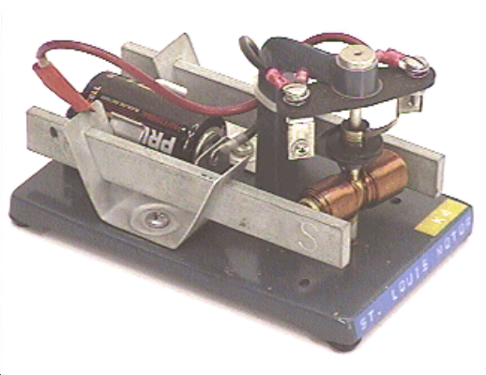
Electric Motor Development (last 150 years)
First motors in mid 1800’s were DC powered by poor batteries
Edison employees developed practical DC machines for DC grid power
Tesla patented the AC motor and the AC grid system in late 1800’s
Electric motors are revolutionizing industry and products to this day
Classical classroom motor for Modern classroom Dyno-Kit
instruction called St Louis Motor for classroom instruction

Slide 8
Basic motor types for first 75 years
DC motors (wound rotor & commutated)
Battery powered
DC supply or M-G set powered
AC motors powered with 50-60 Hz grid
AC Induction & AC synchronous
AC or DC powered
Series wound commutated

Slide 9
Motor types from most recent 50 years
Electronically controlled for variable speed or servo
Stepping motors, VR, PM & Hybrid
PM Brushless & PM-AC synchronous PMSM
AC Induction V/Hz & flux vector controlled ACM
Switched Reluctance SRM
Reluctance Synchronous RSM
Radial, Axial or Transverse flux versions

Slide 10
TESLA Family Tree
SMMA

Slide 11
Electric Machine Definitions
An electric motor is a rotating machine that converts electrical energy from some external power source (can be DC or AC) into mechanical energy across the air-gap between the stationary motor part and the rotating motor part.
An electric generator is a rotating machine that converts mechanical energy into electrical energy. The rotating part is driven by some external prime mover & electric power is produced across the air-gap.
Both can be same machine with opposite energy flow

Slide 12
Magnetic Field Sources
1- Earth’s magnetic field
2- Inner planetary magnetic fields
3- Nuclear magnetic fields
4- Permanent magnet fields
5- Electro-magnetic fields
6- Super Conducting magnetic fields

Slide 13
Magnetic Field created by permanent magnets
Permanent bar magnet in open circuit.
Flux lines extend from north pole to south pole through air or space.

Slide 14
Magnetic Field created by electro-magnets
N
flux
S
Magnetic field from current flowing through the coil wrapped around magnetic iron focuses magnetic flux across an air gap.
Magnetic field produced by a coil with current flowing.

Slide 15
Machine flux linkage overview
Two categories of electric machines: (many types in each)
Non Salient pole & salient pole machines
Salient poles exhibit mainly attractive tangential gap forces
Non-salient poles exhibit both attractive & repulsive gap forces
Torque/amp produced by magnetic flux linkage for motoring
Voltage/rev produced by magnetic flux linkage for generating

Slide 16
Motors with permanent magnet rotors
Original motors of this type called PM Brushless (BLDC).
Evolved as outside-in (PMDC) commutated motors.
Electronically commutated by switching DC voltages
to each phase.
Open circuit back EMF shape between square & sine.
Only SPM types powered with DC phase switching.
(BLDC) motors re-named to (PMSM) when driven by sine hysteresis or I_{d} & I_{q} current similar to an (IM) machine.
Both motors are same with different drives
Back emf can be identical to original
IPM versions must be I_{d} & I_{q} controlled.

Slide 17
DC-AC Drive control chart for motor types

Slide 18
Motors designs included in this lecture series
(IM) AC induction machines, inverter driven
(RSM) Reluctance Synchronous machines
inverter driven
(PMSM) Permanent magnet synchronous
machines

Slide 19
Similar characteristics of
(IM), (RSM) & (PMSM) motor types
Same stator core designs & windings
Same stator manufacturing infrastructure
Same use of active magnetic materials in stator
Similar power inverter topologies using I_{d} & I_{q} control
Note: Each of the three machines types requires a special rotor design an configuration

Slide 20
Three rotor configurations using similar stators
RSM
PMSM
IM
Motor template cross sections by Infolytica

