Slide 1
Electric Machine Design Course
Equivalent Circuit Parameters., Measurements
and Torque vs. Speed Plots
Lecture # 19

Slide 2
Measurements of IM equivalent circuit parameters
The classic and oldest method for calculating the performance of the
AC induction machine is by use of single phase equivalent circuits.
This method is used for three principle purposes :
For teaching and understanding the principles of IMs
E.E. Engineering teams commissioning an IM machine with an
inverter for the first time to optimize all software parameters to
achieve the required output performance of the system.
Before availability of simulation tools, The E.C. was used to predict performance curve results during the design process.
All E.Q. Parameter values were initially calculated
Validation based upon parameter measurements.

Slide 3
Per-phase equivalent circuit of (3) IM
Stator
Current
Rotor Leakage
Reactance
Rotor
Current
Stator
Leakage
Reactance
Phase
Resistance
Magnetizing
Current
Stator terminal voltage
Rotor
Resist.
Magnetizing
Reactance

Slide 4
Equivalent circuit of one phase of (3) phase machine
Supply current = I₁ = magnetizing I² + working I²
Working current or torque producing current circulates
in the rotor cage
Flux vector drives regulate the two current components of the phase current
Using constant V/Hz variable speed control magnetizing
current is regulated by ratios:
460V/60Hz = 7.67 V/Hz
230V/60Hz = 3.8 V/Hz

Slide 5
The equivalent circuit parameter (ECP) measurements for AC induction machines
Three standard test for AC induction
motor parameters
DC Test (Line to Line Resistance)
No-Load Test
Locked-Rotor Test

Slide 6
DC Test for phase resistance
The stator phase resistance (R_{S}).
Apply a DC voltage across stator windings. Measure DC voltage and current
Line to line values/2 = phase values
(R_{S}) = voltage / current

Slide 7
No-Load Test
Conduct no load motor test with uncouples shaft
Apply (3) balanced AC voltages to terminals @ rated f .
Measure current, voltage & input power
Record total losses (core, ohmic, windage & friction)

Slide 8
Blocked Rotor Test
Block rotor shaft to prevent rotation
Apply (3) balanced AC voltages @ 0.25 f .
Adjust AC voltage to produce rate current
Measure Voltage, current and input power

Slide 9
Effect of supply voltage variation with no current control
Fixed frequency
Prof. TJE Miller

Slide 10
Torque vs. speed from grid test

Slide 11
Four quadrant Torque vs. Speed plots
Peak torque
@ base speed
Family of curves tested on an IM using a variable voltage/frequency converter
Note: Peak torques below base speed limited to short times
ABB

Slide 12
Reactance components
Stator Leakage Reactance X₁
Slot leakage
End-turn leakage
Belt leakage
Zig-Zag leakage
Skew leakage
Stator Leakage Reactance X₂
Slot leakage
End-ring leakage
Belt leakage
Zig-Zag leakage
Skew leakage

Slide 13
Reactances & Resistances of AC Induction machines
The following causes & effects at a given voltage and frequency
Magnetizing current & power factor determined by X_{m}
If rotor saturates at low speed (f), decrease voltage
Breakdown torque & starting current are determined by
the leakage reactances
Excessive current causes saturation near stall & breakdown
Starting current controlled by voltage for constant V/Hz drives
Stator & Rotor ohmic losses determined by R₁ & R₂
Starting torque inversely proportional to R₂
Torque vs speed effected by R₂

Slide 14
Equivalent Circuit solution produces Torque vs. Speed curves
AC machine torque @ any fixed
voltage and frequency.
Breakdown
Slip @ breakdown
Prof. TJE Miller

Slide 15
Use of Torque vs. Speed curve analysis
As previously explained, IMs operating from fixed grid AC volts & frequency display speed vs torque plots featuring performance analysis with limited slip, close to synchronous rpm.
Break down torque and starting torques are also of interest
For IMs powered with inverters with capabilities to control both the voltage & frequency, the entire Torque vs. Speed plotted curves of both motor and inverter operating together are of interest.
The motor’s peak torque is limited by it’s rotor teeth saturation as well as the inverter’s maximum current capability.
The max. motor rpm is limited by the max. inverter frequency capability as well as the number of poles in the motor.
Therefore this plotted capability can best be predicted by a study and analysis of 5 or 6 torque vs speed defining load points

Slide 16
Torque & output power vs. RPM for an AC traction motor & inverter
Requires long simulation time to calculate & plot

Slide 17
(5) Load points for performance predictions
The voltage & frequency is optimized for the (5) defining points on the required torque
vs. speed plot.
The rotor teeth must not be in saturation at load points #1 & #2

Slide 18
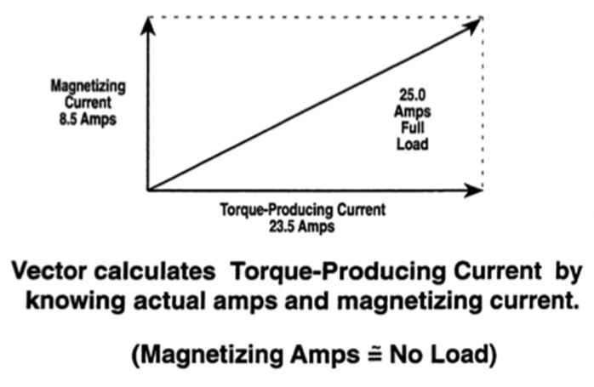
Phase currents & two currents vectors

Slide 19
Title

