Slide 1
Electric Machine Design Course
Poly-Phase Induction Machine Design Strategy
Lecture # 18

Slide 2
Proposed IM design steps for field oriented control
1 - Size machine according to lecture # 5 starting with Stator O.D. & TRV
2 - Assume pole number, desired P.F. & efficiency than estimate rotor volume
3 - Determine air-gap length between rotor & stator/side.
4 - Estimate number turns per phase.
5 - Select number stator slots (Divisible by number of phases, no remainder)
6 - Select stator coil current density & select wire gage
7 - Select stator tooth dimensions for acceptable flux density.
8 - Assume 40% slot fill factor & determine slot depth
9 - Check stator yoke flux density & iterate slot depth and tooth width,
10 - Calculate mean turn length of phase coils
11 - Calculate coil resistance & phase resistance (iterate if necessary)
12 - Select number of rotor slots (at least 6 per pole)
13 - Decide if rotor is skewed or not.
14 - Select rotor bar current density
15 - Determine rotor bar shape, (thickness and length)
16 - Calculate rotor bar and end ring resistances.
17 - Calculate magnetizing inductance and current.
18 - Calculate leakage inductance
19 - Calculate rotor leakage inductance
20 - Use FEA analysis to check for flux densities and distributions
21 - Calculate iron losses, assume windage & friction
22 - Use these results to solve equiv. cir. and compare with original assumed
23 - After iteration is complete solve for efficiency and power factor at desired loads

Slide 3
Steps #1 & 2 , Sizing machine, P.F. & Efficiency
Start with maximum stator O.D. (refer to existing machine listings*)
Select number of poles (Usually four if torque less than 100 Lb-Ft)
Select estimated core lengths based upon the number of poles.
Select TRV & gap stress based upon duty severity and cooling
Set efficiency and power factor goal
Rotor D/L ratio =
F. Fu and X. Tang,
Induction machine design handbook:
China Machine Press, 2002.
Number of poles (2p)

Slide 4
Suggested TRV & gap stress sizing guidelines
10 kPa = 1.45 Psi
Prof. TJE Miller

Slide 5
Typical power factor & efficiency of (3) phase NEMA B IM machines vs. poles & frequency
All data based upon 60 Hz
RPM 512 600 720 900 1200 1800
Poles 14 12 10 8 6 4
Prof. Tom Lipo

Slide 6
* Existing (4) pole IM machine dimensions of rotor & stator cores (ATE)
ATE Germany

Slide 7
* Existing (6) pole IM machine dimensions of rotor & stator cores (ATE)
ATE Germany

Slide 8
* Existing (8) pole IM machine dimensions of rotor & stator cores (ATE)
ATE, Germany

Slide 9
Steps # 3, 4 & 5, Air-Gap length, number of stator slots & turns/phase
Air-gap length needs to be as small as possible but also must be practical for manufacturing. Best beginning strategy is to use gaps from existing machines form lists provided.
Stator slot selection can be based upon past practices but old rules for combinations can be ignored for inverter fed IMs. (see Reliance-Baldor list)
Turns per phase based upon machine size, current available and NI required to produce gap flux density of about 0.85 Tesla.

Slide 10
Air-Gap selection guidelines
Larger air gap increases magnetization (reduces efficiency)
Rotor to stator contact avoidance determined by rotor bearing system
Suggest use Industry air-gap practices for AC Induction machines
Select based upon analytical factors:
Magnetizing current, pulsation losses
Mechanical tolerances, bearing, shaft deflection
Radial unbalanced magnetic forces
Large side loads applied to extended output shaft
Air-Gap thickness does not seem to significantly effect audible noise

Slide 11
Empirical air-gap calculations
Lipo’s chart of gap vs. pole pitch
Lipo’s method:
Say’s method:
p
g
8p
Suggestion:
Should apply to RSM machine air-gap but not
as yet proven.
2p
4p
6p
8p
16p
Pole Pitch (in)
Poles = 2p
Air-gap = g

Slide 12
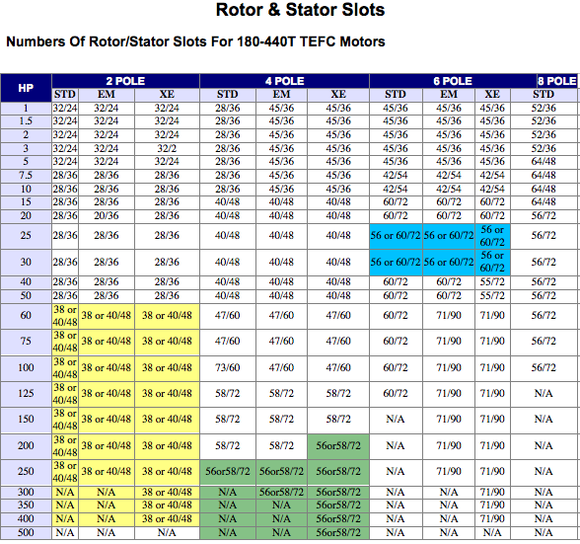
Standard NEMA stator/rotor slot combinations for reference
Reliance-Baldor-ABB

Slide 13
Phase current requirements for IMs
  The phase currents provide magnetization of the
  rotor plus the flux linkage with the stator.
  Volts/phase in stator
  Total Flux =
If air gap flux density, is 35 to 55 Klines/sq-in
(about 0.85 Tesla)
Total flux =
Design of Electrical Apparatus,
by Prof John H. Kuhmann

Slide 14
NI requirements for IMs
Amp-Turns/pole required to send flux across air gap:
ATP = NI/pole to magnetize circuit
ATP= AT_{g} + AT_{ts} + AT_{tr} + AT_{ys} + AT_{yr}
Effective magnetizing current/phase =
Turns/ coil is determined by voltage, power & current.
(Turns/coil varies directly with voltage)
B = lines/in-sq.
g = air gap (in)
K_{s} = Carter coef.

Slide 15
Calculate number of turns per coil
Calculate number of stator turns per phase depending on previous B, D, L, supply voltage (math) and assumed flux density shape f_{a}
Flux per pole
B_{g} = 2p Φ_{m}/(πDL) to find Φ_{m}
Κ_{Ε}: typically 0.85-0.95, higher for large power rating or small pole number
Back EMF factor
Turns per phase
K_{f} : form factor, typically assumed = 1
K_{w1} : winding factor for fundamental = typically 0.955
f : fundamental frequency

Slide 16
Strategies for number turns per coil
Frequently less than a single turn/coil adjustment is desired for performance.
Parallel circuit paths offer the option of effectively achieving fraction turn changes
Four turns/coil with one current path can be adjusted to 4.5 turns per coil with two parallel current paths and 9 turns per coil..
Another strategy to achieve ½ turn adjustment is to connect the phase neutral on the opposite side from the phase lead connections. This also reduces the end turn height bundle on the lead side of the stator by moving the neutral connection bulk to the opposite end turn side.
These comments apply to all machines types discussed in these lectures.

Slide 17
Steps 6, 7, 8 & 9 Determine stator slot to tooth dimensions, slot depth & densities of current and flux
From initial current and flux estimates the slot & tooth densities can easily be determined by dividing be the respective cross sections or solving for dimensions based upon accepted densities.
Note the tooth flux density is based upon the total air gap flux divided by the number of stator teeth per pole.
The stator yoke must support half of the gap flux per pole because the tooth flux splits into two paths so the yoke cross section area is one half (or more) than the teeth cross section per pole.
Slot depth changes has a greater affect on slot area more than slot width adjustments & higher tooth flux densities are more acceptable than high yoke flux densities with respect to iron core losses.

Slide 18
Typical phase conductor current densities

Slide 19
Flux density guidelines by two experts
Select suitable values of flux density in stator back iron and compute stator outer diameter. (for 60 Hz, ordinary electric steel, lower for higher frequencies)
Position | Typical flux density range (Say) | Maximum flux density (Lipo)
Airgap Bg | 0.65 – 0.82 T (ave.)
Stator yoke | 1.1 – 1.45 T (peak) | 1.7 T
Stator teeth | 1.4 – 1.7 T | 2.1 T
Rotor yoke | 1.2 T | 1.7 T
Rotor teeth | 1.5 – 1.8 T | 2.2 T

Slide 20
Steps #10 & 11, Phase coil mean turn length & phase resistance
The resistance of each coil is determined first and then the phase resistance
Determine the mean turn length first from the center path of each turn.
Multiply the MTL times the number of turns/coil times the wire gage resistance per inch or mm.
The phase resistance is the sum of the coils in series per phase or the sum of the reciprocal of the coil resistances in parallel per phase.
When a combination of series & parallel coils result Ohm’s laws are applied.

Slide 21
Calculate stator winding resistance
Calculate stator winding resistance (approx. math – end turns)
Resistively of conductors
(look up in gage table)
Estimate end length l_{end}
Conductor cross sectional area (standard wire gauge)
Stator resistance
Harley & Duan

Slide 22
USA Wire gage chart with resistance/meter

Slide 23
Steps #15,16, &17 Select rotor bar details, number,
shape and resistances of bars and end rings
Number of rotor bars and shape must be based upon minimizing leakage inductance and cage resistance. (ignore old rules)
Number of bars should not be less than 6 bars or slots/pole
For IMs with pole numbers greater than (4), consider 7 to 9 bars/pole
To minimize leakage inductance position bars close to rotor O.D.
Bar shapes can be parallel sided for large machines or tapered for smaller machines. (Double bars not advised for inverter IMs.)
Use of copper bars & end rings permits lower cage resistance
Bar retention and stability must be considered with bar design.
8

Slide 24
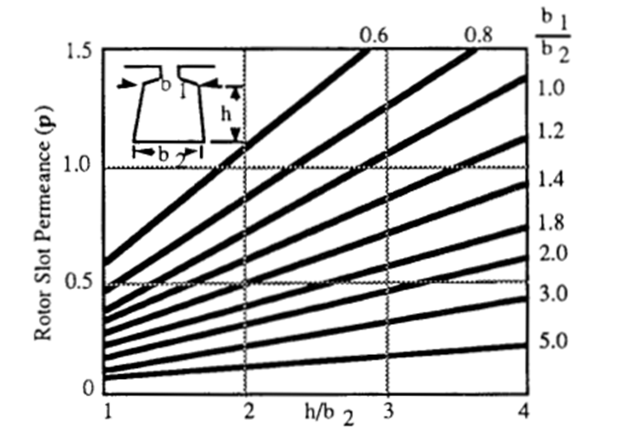

Rotor Leakage Permeance vs. Rotor Slot Shape
Suggested Rotor slot proportions: & 8

Slide 25
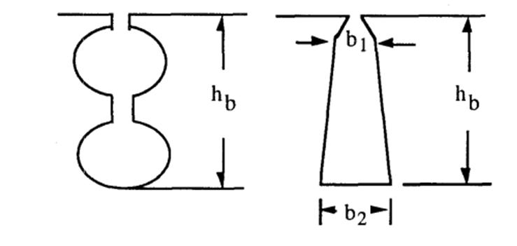
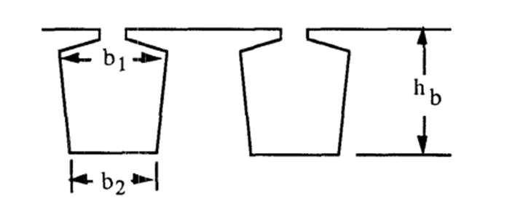
Rotor bar considerations for inverter driven IMs
Typical bar shapes for grid powered IMs
Principle design criteria is improving starting torques
Typical bar shaped=s for inverter powered IMs
Principle criteria are low leakage inductance & resistance

Slide 26
Cage resistance calculations
Divide bar number by number of poles for bar resistance and use bar cross section and Al or Cu resistivity to calculate bar resistance.
End ring radial cross section where intersecting bars can be used to calculate end ring resistance.
Extra end ring thickness assures lower current density in end rings than current density in bars which attracts heat form Ohmic losses from bars into spinning end rings.
For fabricated copper rotors copper bars are used with bronze end rings.
Sometimes steel end rings are added to copper end rings for balancing and rotor stability for high speed machines. (ignore steel cross sections)

Slide 27
IM operation envelope (motor & inverter)
Desired performance must be contained inside envelope of family of T vs. f
curves
Each plot is at
fixed voltage & frequency
Note: Torque vs speed plot has been corrected
Siemens

Slide 28
Steps # 17 through 23 covered in Lecture 22

