Slide 1
Electric Machine Design Course
Stator Phase Circuits & Coil Design, Part 1
Lecture # 14

Slide 2
Stator coil design guidelines
Copper to slot fill factor should be maximized for lowest Ohmic losses
Phase coils can be form wound or random wound for insertion
Coils can be air wound in special tooling
Coils can be wound in place, machine inserted or hand inserted
Slots can be open, closed or semi-closed
Large machines require end turn support against vibration
Large conductor cross sections require multiple strands in hand
Each three phase wye circuit should use separate neutral connection
Phase coils can be either single layer or multiple layer type.
Identical number of conductors/slot results in best designs.

Slide 3
Stator slot & conductor details

Slide 4
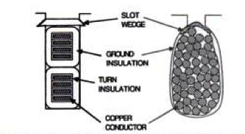
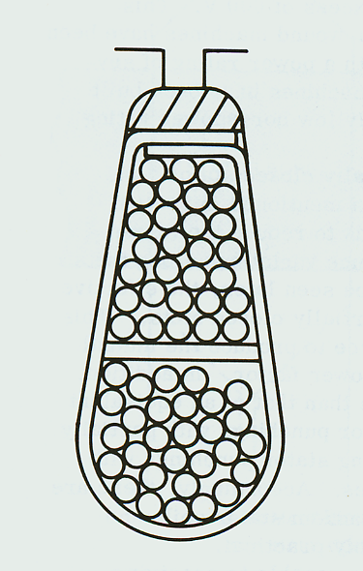
Phase coil types
Open slot
form wound
Semi-closed slot random wound
Open slot
form wound

Slide 5
High slot fill concentrated windings
US Patent # 6,583,530

Slide 6
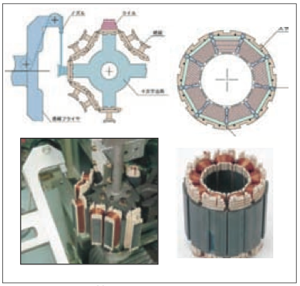
Various stator iron & coil design combinations

Slide 7
Stator slot fill discussion
Slot fill of random wound Air wound coils Form wound coils (to 65%)
Phase slot fill using segmented core.

Slide 8
Examples of high slot fill phase windings to minimize Ohmic losses
FORD
TOYOTA

Slide 9
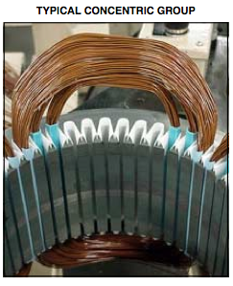
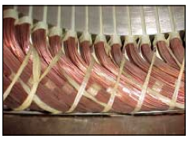
Phase coil end turn extensions
End turns from random wound coils after insertion in cuffed slot liners. Note, large end turns cannot be left un-attended.
End turns are shown formed or blocked and laced together tightly before applying varnish to restrain conductors against vibration.

Slide 10
Form wound coils & end turn supports

Slide 11
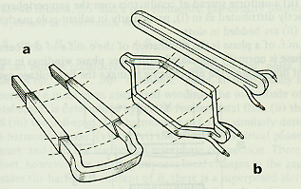
Form wound coils for open slots

Slide 12
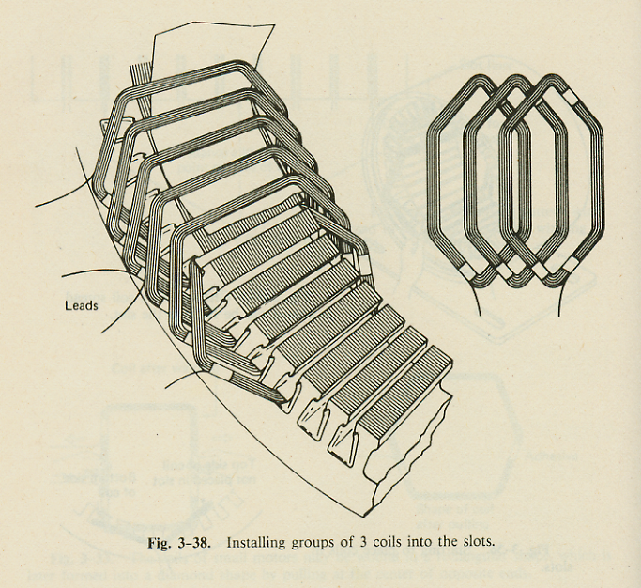
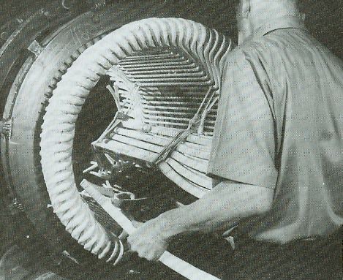
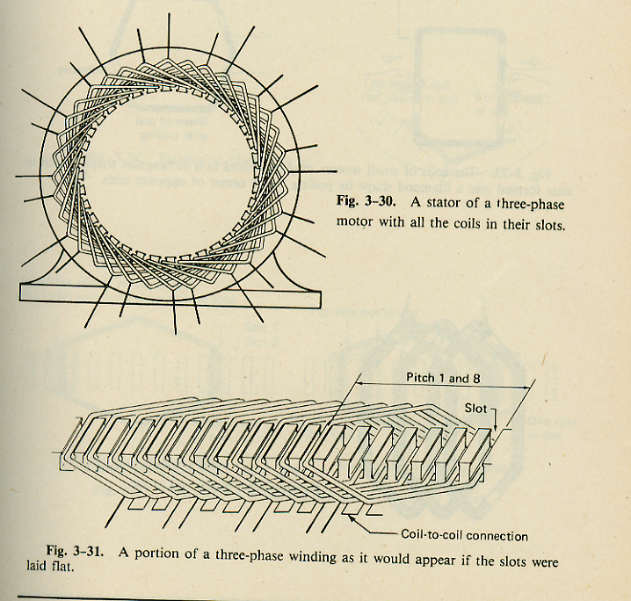
Lap installation of form wound coils

Slide 13
Coils designs for small machines

Slide 14
Roebel coil assembly details in stator slot

Slide 15
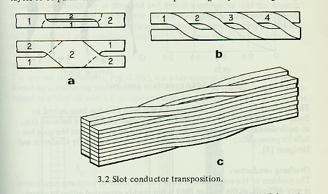
Parallel path conductors per coil turn. (Roebel Coils)
Transposition of parallel conductors to all slot positions for equal currents in each conductor

Slide 16
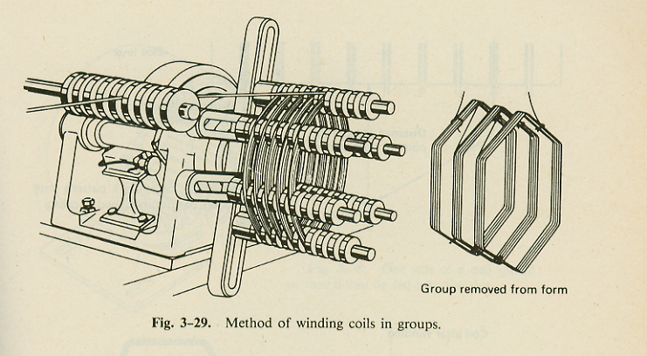
Random wound phase coils groups

Slide 17
Air wound coils lap assembled for dual gap slotless motor

Slide 18
Air wound coils for axial flux stators

Slide 19
Phase coil design tips
Most if these tips apply to both very small machines and very large machines, even though their implementations will be different.
Single strand magnet wire to stranded lead with can be soldered
Multi-strand magnet wire is best crimped in a copper sleeve or terminal
(Same to applies to neutral connections)
Neutral connection can be located in either end turn pack
When in phase lead end, full turn counts per coil result
When opposite lead half turns can be quite useful
Each parallel circuit path should use separate neutral connection
Delta winding substitution for wye connection eliminates neutral connections. (Very useful if end turn height space is limited)
(Turns/coils must be changed)

Slide 20
Title

Slide 21
Title

