Slide 1
Electric Machine Design Course
Stator Insulation System vs. Voltage & Temperature
Lecture # 13

Slide 2
Introduction to motor insulation design
Grid machines are designed to UHV (ultra high voltages to 70,000 VAC)
Motor types discussed in these lectures are intended for inverter operation rather than grid AC powered or battery powered
IGBT transistor DC link voltage ratings are about 2.8 KV
(Development work is on-going to extend to 8 KV)
UHV machine for grid power require very special insulation materials
Enameled magnet wire, Nomex & Kapton & trickle varnish or VPI
Trickle varnish used for high volume small motors
VPI most advanced process for all most all larger motors
High voltage machine use Mica and Bakelite

Slide 3
Insulation thickness vs. voltage
Average dielectric strength of most materials = 1 KV/mil
High performance materials up to 4 KV/mil
Motor voltage classes vary with vendors & countries
LV under 480 VAC
MV 481 to 6000 VAC
HV 6001 to 20,000 VAC
UHV 20,001 to 70,000 VAC
Higher voltages require special & thicker insulation materials

Slide 4
Stator insulation basics
Stator phase coils must be insulated against ground, phase and turn shorts
Turn to turn shorts are insulated by by conductor enamel or tape wrapping.
Ground shorts are prevented by slot insulation,
Slot liners & end boards
Slot liners that are cuffed at each end of core
Epoxy powder coating for low voltage stators
Molded tooth bobbins or coil forms
Phase shorts are prevented by added insulation
Slot inner slot phase strips
Fiberglass sheets in end turn phase overlaps

Slide 5
Stator insulation components

Slide 6
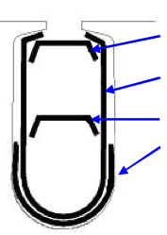
Slot Insulation Details
Slot-Liner
Wedge
Slot Separator
Extra liner
Slot–Liners are usually Cuffed
to space end turns from core face

Slide 7
Stator slot insulation design options
Slot insulation components
Epoxy powder coated
Cuffed slot liners
Injection molded

Slide 8
NEMA insulation class ratings
Based upon insulation half life for each10 deg C rise a motor operating at 180 deg C would have an estimated life according to the following classes

Slide 9
Insulation failure from PWM inverters
Copper magnet wire coating grades
Single build, double & triple build
Coating process results in pin holes
PWM inverters cause voltage spikes or standing voltage waves
Peak voltage transients can cause rapid corona failure of insulation due to ozone formation.

Slide 10
Inverter duty insulation systems
PWM inverters can cause corona insulation faults
Wind phase coils with inverter duty wire
Sleeve first & last turn of each phase
Double or triple dip & bake in varnish
Alternate-encapsulate stator in epoxy

Slide 11
Insulation material temperature ratings

Slide 15
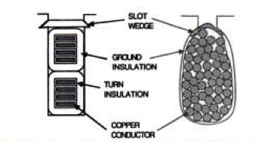
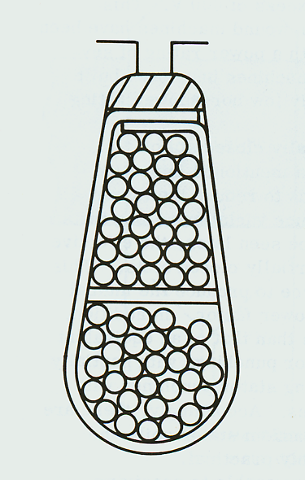
Phase coil types
Open slot
form wound
Semi-closed slot random wound
Open slot
form wound

Slide 16
Insulation steps for slot coils

Slide 17
Phase to phase insulation
Under 200 - 250 VAC, phase to phase insulation usually not required
For higher voltages the phase coils must be insulated from each other both in the slots and in the end turns. (See slide 135 & 136)
The insulation between coin
end turns is usually cut from
sheets of woven fiberglass.
Items 1 shown are coil end
Conductors. Item a points to
Cut and turn insulator

Slide 18
Insulating form wound coils used in higher voltage larger machines with open slots.
Form-wound coil insulation components as the coils exits the stator core [1]. The strand (and often turn) insulation is c, the ground insulation is 2, d shows the locations of the slot conductive coating and e is the stress relief coating.

Slide 19
Tape insulation of formed coils

Slide 20
Title

Slide 21
Title

