Slide 1
Electric Machine Design Course
Stator Laminations & Core Design Studies
Lecture # 12

Slide 2
Lamination cross section proportions
AC Induction:
Assume air gap circumference flux = 1.0 Tesla
All stator teeth carry total air-gap flux
Low pole numbers, max O.C. tooth flux = 1.7 T
High pole numbers, max O.C. tooth flux density = 1.4 T
Yoke flux based upon 0.5 pole flux, Max = 1.4 T
Reluctance Synchronous:
Assume air gap circumference flux = 1.0 Tesla
Stator teeth carry ~ 2/3 air-gap flux
Low pole numbers, max O.C. tooth flux = 1.7 T
High pole numbers, max O.C. tooth flux density = 1.4 T
Yoke flux based upon 0.5 pole flux, Max = 1.4 T
SPM or IPM Brushless:
Determine air gap flux/pole from magnet design
Stator teeth over rotor pole span carry rotor pole flux
Low pole numbers, max O.C. tooth flux = 1.7 T
High pole numbers, max O.C. tooth flux density = 1.4 T
Yoke flux based upon 0.5 pole flux, Max = 1.4 T

Slide 5
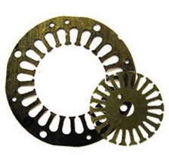
Punched core laminations
Rotor cores punched from stator ID in progressive die reduces material cost.

Slide 6
Yoke thickness of stator or rotor
B = average air-gap flux density
By = peak yoke flux density
D = rotor OD
Yoke thickness varies as the number of poles vs stator
OD & rotor ID for fixed stator slot depth & rotor OD

Slide 7
Flux density guidelines by two experts
Position | Typical flux density range (Say) | Maximum flux density (Lipo)
Airgap Bg | 0.65 – 0.82 T (ave.)
Stator yoke | 1.1 – 1.45 T (peak) | 1.7 T
Stator teeth | 1.4 – 1.7 T | 2.1 T
Rotor yoke | 1.2 T | 1.7 T
Rotor teeth | 1.5 – 1.8 T | 2.2 T
Max flux density in stator yoke & teeth for ACM & RSM
For open circuit PMSM machines, 1.2T/1.4T in yoke &
1.4T/1.6T in teeth for max flux density. (JRH)

Slide 8
Air-Gap correction factor (Carter Coefficient)

Slide 9
Rotor & Stator Laminations
Magnetic circuit dimensions of magnetic circuit optimized for
flux densities

Slide 10
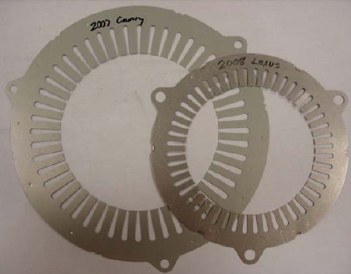
Toyota Camry & Lexus stator lams

Slide 11
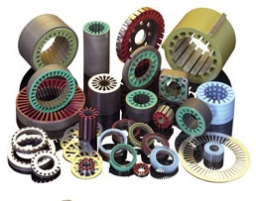
Stacked & insulated stator cores

Slide 12
Laminated stator cores

Slide 13
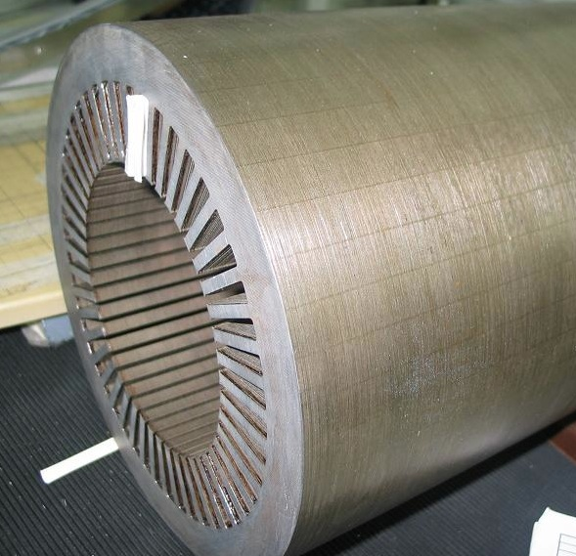
Stator cores stacked from thin laminations

Slide 14
Segmented stator design using either laminated stacked teeth or Sintered teeth.

Slide 15
Skewed rotor cores for AC motors
Die interlocking principle
Mitsui High-tec

Slide 16
Large Turbo Generator Cores
Notice- Finger Plates on core end to prevent lamination vibration

Slide 17
Stator cores for rail traction motors
End turn supports

Slide 18
Finger –Vent Plates
Fabricated by stamping and spot-welding
Finger Plates on
core ends prevent
lamination vibration
Vent plates in between axial groups of laminations

Slide 19
Sintered magnetic motor cores

Slide 20
Unusual laminated machine cores
Axial flux stator
pole assembly
Slinky stator core
Strip-wrap-up
Stator core
Stator/Rotor lam for PMSM-IPM

Slide 21
Title

Slide 22
Title

