Slide 1
Electric Machine Design Course
Stator Configuration Design Criteria
Lecture # 11

Slide 2
Introduction to electric machine stator design
Stator requirements are similar for IM, SRL and PMSM machines
Use low core loss soft cross sections of laminated or sintered iron
Avoid magnetic saturation in cross sections (< 1.3 to 1.8 Tesla)
Avoid thin tooth tips on semi-closed teeth in PM machines
Avoid any lamination shorts adjacent to magnetic air-gaps (ID)
Cores should be stacked using tooling to produce accurate cores
Cores should be protected from rust (varnish, paint or encapsulation)
Similar guidelines apply to axial flux stators with slight modifications

Slide 3
Stator design for maximum efficiency
Minimize stator core losses:
Opt for low commutation frequencies and flux densities (core losses)
Punch laminations from thin gage steels with insulation coatings
Compare fully or semi-processed vs. post-annealed laminations
Consider sintered electrical steel stator core components
If magnetic allows use oriented electric steels
For minimum core losses consider use of Amorphous cores (MetGlas)
Minimize Ohmic losses in stator phase circuits
Use largest wire gages possible for maximum slot fill
Minimize phase coils end turn lengths
Use square or rectangular wire magnet wire where possible
The optimization of both strategies above requires copper & iron balance
Given, existing lamination, adjustments of core lengths can be optimized

Slide 4
Stator core design guidelines
Laminations should be stacked using alignment fixturing for both by hand or by automation.
Laminations should be stacked with stamping burrs facing in same direction. (So as to nest them together)
Half of the core length should be rotated 90 degrees
Radial mis-alignment reduces wind slot area
I.D. eccentricity from one lam to another must be avoided
Cores should be compressed under high force at 90 to stack for squareness and flatness compression.
If welded, weld over center of teeth and do not over weld
Never use filler metal, use TIG, Laser or Plasma
Several small welds, (1.5 mm wide and 0.25 to 0.50 mm deep)
No weld depressions nor grooves are necessary
No extended weld protrusion will result on laminations

Slide 5
Stator lamination design guidelines 1
Progressive dies
Used for punching
of Stator & Rotor
Laminations
Laser cutting for prototypes
Wasted material
~20% in corners.
Punch rotor core from stator hole whenever possible

Slide 6
Laminations core fastening options
1- Riveting (Obsolete and seldom used in modern times)
2- Cleating in notches in OD (seldom used in new designs)
3- Bonding (used for small motors, high performance machines
and of course prototypes.
4- Clamping around OD on yoke or end clamp plates on rotors
5-In-Die interlocking of lams for finished stacked cores from die

Slide 7
Stresses on stator cores
Nippon Steel

Slide 8
Conventional vs. Mac System for rotor & stators
Mitsui High-Tec Inc

Slide 9
Lamination set from AC Induction machine
(36) semi-open stator slots with round slot bottoms
(40) semi-open rotor slots with round slot bottoms
Probably for a 4 or 6 pole 10 KW machine

Slide 10
Core assembly examples
Neat small TIG welds
Grooves for OD end clamps (not used)
Welding OD clamps
on large stator core
Inter-locking
dimples

Slide 11
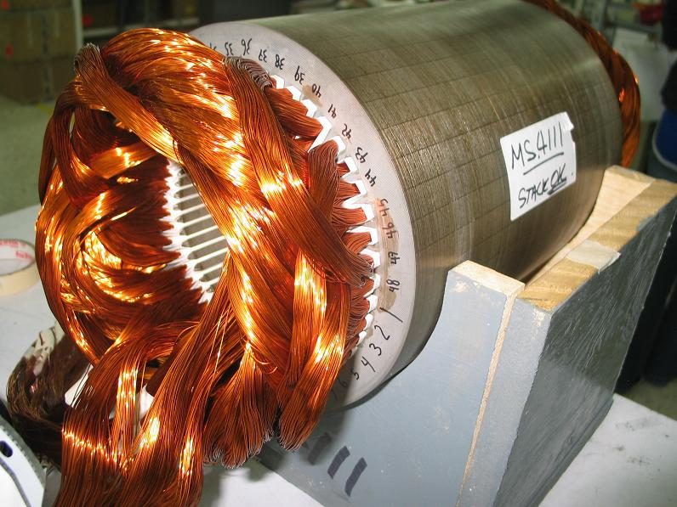
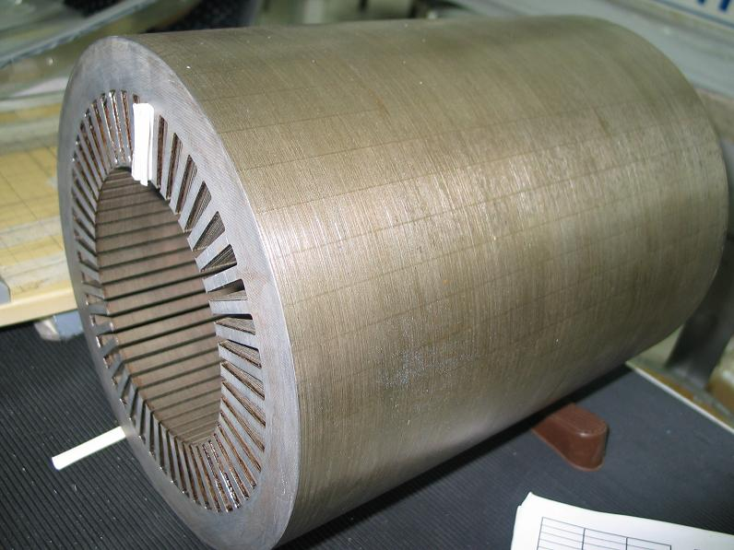
(4) Pole Traction motor stator core & winding
Hand stacked core and bonded
Machine wound coils & hand inserted
35% to 45% slot fill of bare copper to
slot cross section area
Machine insertion 25% to 35% slot fill
Use of rectangular wire like REMY motor, 60 to 75% slot fills are possible

Slide 12
High slot fill stator core designs

Slide 13
Mechanical considerations for stator cores
Finger plates required
for vibration control, noise
& coil insulation wear.
Cooling passages for
excessive thermal
diffusion distances.
Bracing of end turns to withstand vibration and
magnetic forces
Stator ducts
Rotor ducts
End turn brace

Slide 14
Another example of end turn bracing
End turn bracing allows thermal expansion

Slide 15
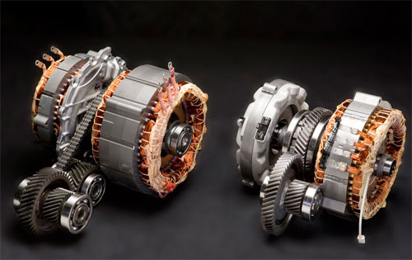
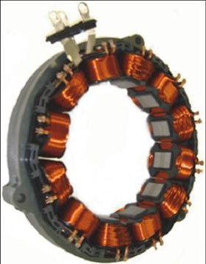
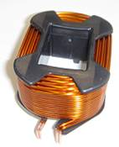
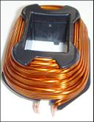
Toyota stators
Parallel wound Taper wound
Special layer wound coils for high slot fill

Slide 16
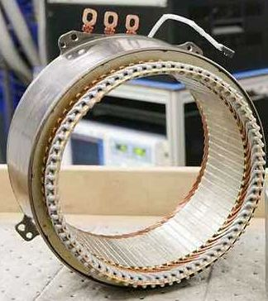
10 Pole stator by REMY

Slide 17
Advanced stator design for super conducting machine
Coil end turn supports
Stator teeth end fingers
Patent # 6,787,967

Slide 18
Title

Slide 19
Title

