Slide 1
Electric Machine Design Course
Selection of Phases, Poles, Stator & Rotor Slots
Lecture # 10

Slide 2
Selection of number of phases (m)
Most inverter fed machines perform well using three phases
Therefore available IGBT & MOSFET bridges are for (3) phases
Two (3) phase circuits are sometimes used for fault tolerance
Large machines frequently use multiple (3) phase circuits
Stepping motors utilize (2), (3) & (4) phase stators
SR (switched reluctance) machines use (2), (3), (4), (5) & (6) phases
These lectures are all based upon (3) or multiples of (3) phases

Slide 3
POLES, SLOTS & PHASE SELECTION (Certain items not applicable to IMs or RSMs)
1-Three phase most common, six phases reduces phase current by one half.
2-Single phase not uncommon for PM generators.
3-Torque density increases with increased number of poles.
4-Iron losses increases with increased number of poles.
5-Transistor losses increases with increased number of poles.
6-Integral number or fractional number of slots to number of poles.
Fractional slot combinations yields lower cogging torque.
7-Ratio of slots to pole numbers determines winding choice options.
Minimizing end turn length is sometimes most important issue.
8-Only certain combinations possible for balanced distributed phase windings.
9-Multiple 3-phase circuits further limits choices of slots & poles.
10-Ideal winding distribution factor of unity is effected by number of slots to poles.

Slide 4
Guidelines for slot-pole selections
Pole number guidelines
Higher pole numbers yield higher torque densities & power to some degree. (Increasing speed easily increases machine power density)
Design options when increasing pole number with thinner yokes
Larger rotor O.D. or smaller stator O.D. or larger rotor I.D.
Sine currents require ~ 20 PWM chops per cycle 20f = PWM freq.
Stator slot selection guidelines
Integral slot windings yield highest winding factor, mod (S_{s},m) = 0
Fractional slot numbers yield short end windings. S_{s} mod 2p ≠ 0
Fractional slot stators are automation friendly & low cost.

Slide 5
Selection for number of rotor poles (2p)
Induction Motor Pole Selection:
(4) pole limit for inverter AC induction > 1300 Nm
High poles decreases efficiency & power factor
Reluctance Synchronous Motor Pole Selection:
Most any number depending upon rotor diameter
Determined by rotor pole saliency design
Saliency ratio must be as high as possible
PM rotor machine pole selection:
Select highest pole number allowed by inverter
Depends upon rpm and Inverter carrier frequency
(Rotor pole number need not = stator pole number)

Slide 6
Effects of different slot ratios and pole numbers
Different slot ratio results of changing pole numbers & rotor diameters
(O.D. unchanged)
O.D. change vs. number of poles and fixed rotor diameter
Prof. W. L. Soong
U of Adelaida

Slide 7
Pole selection guidelines for AC Induction motors
Also applies to RSM motors (JRH)

Slide 8
Pole selection for PM-DC or PM-AC brushless
High pole number increases flux leakage & increases torque density
(2) poles ~100 Krpm and higher
(4) poles up to ~50 Krpm
(8 -10) poles up to ~25 Krpm
(12) & higher for very low speed “torquers”
Advantages of increasing number of poles are;
1 Reduction in active material cross sections including
soft iron for stator & rotor cores and magnet thickness.
2 Higher pole numbers reduces magnet cost
3 Rotor diameter can be larger with same stator diameter
4 Stator diameter can be smaller with same rotor
5 Reduction of phase resistance improves efficiency, due to smaller coil lengths (end turns)
Disadvantages of higher pole numbers:
1 Flux leakage varies directly with pole pair number
2 Iron losses increase with higher pole pair numbers
3 Higher PWM frequencies required with more poles

Slide 9
End turn resistance vs number of poles (Lowers ohmic losses and increases efficiency

Slide 10
Pole selection for RSM machines (salient pole rotors) (Reluctance Synchronous Machines)
Best advice is to use standard (4) pole ‘IM stator
Many pros & cons relate to PM machines pole selection apply
Inductance ratio of d axis to q axis is most important design factor
Flux carrier & barrier rotor proportions require sufficient material ratios to achieve L_{q} / L_{d} ratio over 5 (8 to 10 preferred)
Maximum pole number depends upon rotor circumference
Typical designs tend to have pole numbers equal to existing AC induction motor stator lamination used for design (normally 2p).

Slide 11
Slot & pole considerations for 3 - phase balanced windings
Stator slot number vs phases, mod (S_{s},m) = 0
Limited list of combinations of slots & poles
The multiple phase coil location possibilities result in different winding distribution factors. (Max = 1.0)
Select winding with highest distribution factor

Slide 12
Stator slot number (S or Q) selection for three phase windings
Suggested guide lines:
Slot number (S), mod (S, m) = 0
(3 ,6, 9, 12, 15, 18, 21, 24 ,27, 30……)
Phase windings should be balanced:
All slots are filled with same number of conductors
with location of phases in slots to be 120 deg E
apart. Slots/pole/phase, (S_{s}/2p/m) ≤ 2
If (S_{s}/2p/m) 1≤, known as fractional slot winding with
phase coils spanning single teeth.
If (S_{s}/2p/m) ≥1, known as integral slot winding with
phase coils spanning two or more teeth.
(Slots = (S_{s}) in USA, = (Q_{s}) in Europe)

Slide 13
Possible slots/pole/phase for balanced windings
In publications such as ISBN 978-0-9840687-0-8 lists of slot/pole combinations for balanced windings are provided in chapter # 3.
Based upon a few simple rules a list of slots/pole choices that cannot provide balanced windings are provided on the next slide.
Number of stator slots must be divisible by number of phases
with zero remainder: mod (S_{s},m) = 0
Each group or set of phase coils must be located equally spaced around stator set of slots used for each phase: 360^{O}/m
Phases Phase coil set spacing
2 180^{O}
3 120^{O}
4 90^{O}
5 72^{O}
6 60^{O}

Slide 14
Impossible slot-pole combinations for balanced three phase windings

Slide 15
Rotor bar number choices for AC induction rotors
Historical rules abound for choosing rotor bar numbers
Rules based upon experience with grid powered AC machines under fixed voltages and frequency.
Bar number (Q_{r}) should never equal stator slot number
Bar number guidelines:
(2) & (4) pole, bar number = 80% of stator slots
(8) or more poles, bar number = 120% stator slots
All rotor positions, select bar number for lowest number
of aligned slot openings of stator to rotor slots.
I use a minimum of 5 to 7 bars per pole

Slide 16
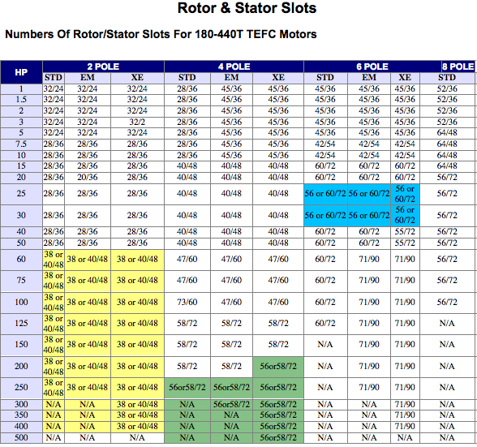
Stator slots vs. rotor bars for NEMA AC motors
Reliance (ABB)
EM = “E” Master
EX = premium efficient

Slide 17
Grid motor rotor bar number rules
|N1 - N2| < > P+/- 2 where P is number of poles
|N1 - N2| < > 3 * m * P where p is integer
|N1 - N2| < > 5 * P
N2 should be above or below N1 by at least 15 bars or 25% of N1.
N2 is generally not odd
N2 should not be twice a prime number
N2 should not be divisible by the number of poles
Some designers prefer N1 > N2 although there are lots of exceptions
N1/N2 = 24/19 is a relatively common ratio
These rules are intended for grid powered motors.
Another famous list is by Dr. Syrel Veinott is in his priceless book,
Theory and Design of Small Induction Motors,
Electrical Apparatus Magazine
By R. By R. Nailen, June 2005

Slide 18
Title

Slide 19
Title

